Slide 1
Judy MIELKE, PhD. Publisher @ Taylor & Francis
Staying relevant in times of change:
A suggestion for academic journals
Notes:
Are journals meeting societal needs?

Slide 2
About me
Academic at heart: PhD in immunology
Publishing context: 7 years in editorial focusing on content at Wiley-VCH
Open scholarship: 3 years in editorial focusing on journal development at Frontiers Media SA
Current role: Publisher at Taylor & Francis, Stockholm
Notes:
Disclaimer to my points of view

Slide 3
A view of the research ecosystem
FUNDER
RESEARCHER
JOURNAL
Notes:
Simple view of the research ecosystem

Slide 4
From ivory tower...
Ed Webster - CC BY 2.0
Notes:
Society is changing, public´s demand for transparency is increasing. Technology is also enabling funders to be more data-driven in their funding decision process.

Slide 5
... to social media
Ed Webster - CC BY 2.0
Notes:
Demand for transparency

Slide 6
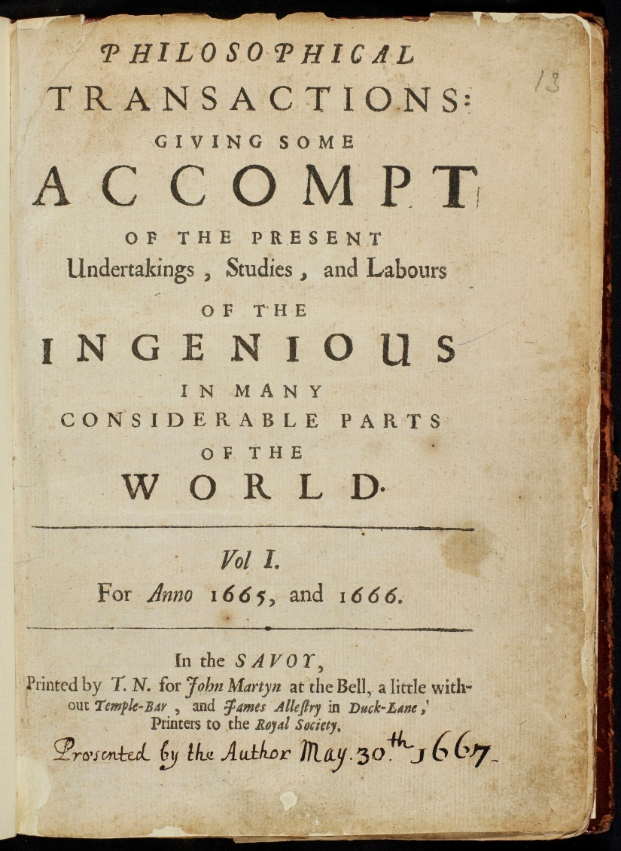
Basic purpose of a journal
Validate
(peer review)
Communicate
Royal Society / CC-BY 4.0 International
Notes:
Journals validate research and faciliate dissemination of research knowledge
Philosophical Transactions recently celebrated its 350th anniversary. 1665

Slide 7
A reality among journals
Indexation / Ranking
Page Budget
Rejection Rate
Notes:
Journals need to consider their impact factor
Journals need to publish within a certain page budget
Rejection rate is a ”badge of honor”
Arbitrary limit on number of references
Publish what would be cited
Reject more papers
Reviewer fatigue

Slide 8
A reality among researchers
Funding
Measure
Peer Review
Notes:
Publish or perish
Selective publishing
Authorship issues
Follow the trend... what does the editor like?
Too many review requests
Be a “tough” reviewer

Slide 9
A common reality of funders
Funding
Measure
Notes:
Invest in research that meets mission
Fund only the best researcher/s
Measure the results of our funding
Using journal IF as a way to measure research output

Slide 10
Are we here to...
Be destructive reviewers...
Reject papers...
Publish only a subset of funded studies...
Follow impact factors...
Notes:
Image: CC0, no image attribution required

Slide 11
Nick Youngson CC BY-SA 3.0 Alpha Stock Images

Slide 12
Common challenges
Measure
Impact
Funding Transparency
Unpublished Research
Peer Review Transparency
Peer Review Efficiency
Reviewer Fatigue
Disseminate Research
Information Overload
Notes:
Measure impact
Transparency – funding and the research process

Slide 13
Disseminate Research
Access to publicly funded research
Foundation for further research
Text & data mining
Better discoverability

Slide 14
Potential pitfalls of OA
Funding situation in different fields
COI: revenue & acceptance
Perceived quality?
Notes:
Funding structure may mean that not all fields are OA ready
Relatively low entry requirement

Slide 15
Potential solutions to OA challenges
Editor compensation unlinked from acceptances
Article processing charges for all submissions?
Transparency in peer review

Slide 16
Open peer review
Reviewer / author identity
Review process
Reviewer reports
Manuscript revisions
Notes:
Open peer review – umbrella term
Reviewer identiy known
Reviewer reports open
Open review process
Controversial subject areas
Willingness to review
Are the reports for the authors or for the record?
Challenges associated with adapting to a new system
Image: CCO, no attribution required

Slide 17
Reviewer fatigue
Soundness versus impact
Notes:
Reviewer fatigue
Peer review transparency

Slide 18
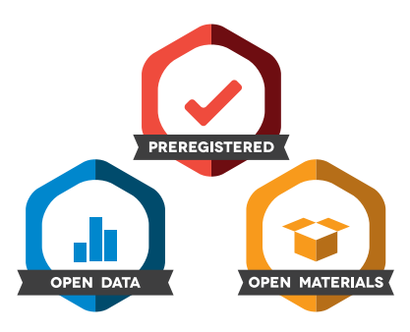
Overcoming publication bias
Notes:
Scientific question relevant to my journal?
Is the study design valid
Addresses: publication bias, unpublished results, transparency to research progress
Caveats: researchers must have the fleixbilty to deviate from original study design, if necessary
Linkage: ICTRP, International Clinical Trials Registry Platform

Slide 19
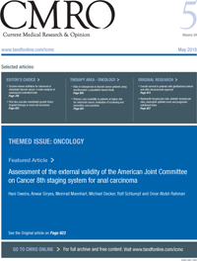
Overcoming publication bias
Notes:
Linkage: ICTRP, International Clinical Trials Registry Platform
AllTrials estimate that 50% of trials are not reported.
- Investigators´ motivation
Commercial interests
Journals
Funding?
Journals that welcome negative studies, confirmatory studies
Journal of Drug Assessment
Current Medical Research and Opinion

Slide 20
Open Data
Findable
Accessible
Interoperable
Reproducible
https://www.force11.org/group/fairgroup/fairprinciples
Notes:
Very little data is fully “FAIR” today. Not only due to researchers not attaching appropriate meta-data and taking other steps to make it FAIR, but also due to systemic changes that need to be made across the scholarly landscape.
This slide provides a reminder of what FAIR stands for and where one can go for more information.

Slide 21
Notes:
Data sharing guidelines at T&F

Slide 22
Citation practices
UK Data Service
Notes:
Operating within the realms of the scientific record
Remove traditional barrier of limiting reference numbers
Holistic way of measuring impact

Slide 23
Preprints
Notes:
Preprints: ”scooped” – change culture to have preprints as a way to demonstrate precedence

Slide 24
Research Dissemination

Slide 25
Measuring Impact

Slide 26
Information overload: AI

Slide 27
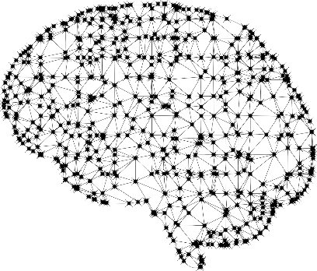
Technology and human innovation
Register
Research
Publish
Disseminate
Measure

Slide 28
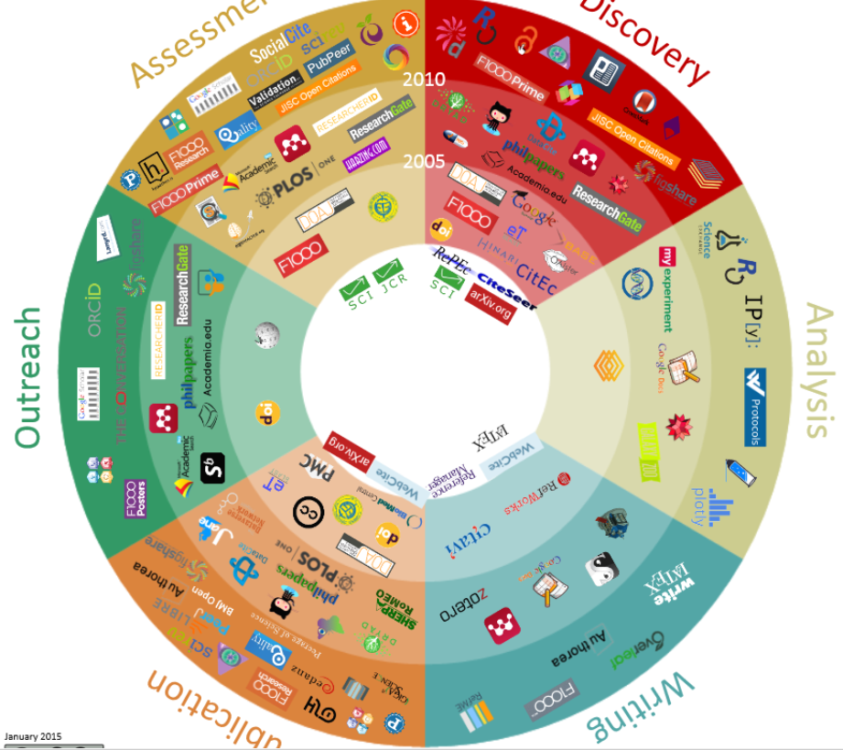
Judy.Mielke@informa.com

