Slide 1
The Activities of COPE: Code, International Standards and Best Practices on the Ethics of Scientific Publications
The 7th International Scientific and Practical Conference “World-class scientific publication”
24 April 2018, Moscow, Russia
Behrooz Astaneh M.D
COPE Council Member
Head, Medical Journalism Department, Shiraz University of Medical Sciences
Editor-in-Chief, Iranian Journal of Medical Sciences
Vice President, EMAME
Vice President, Iranian Society of Medical Editors

Slide 2
History of COPE
1997 by three editors of UK based journals
Rapid progress during the last 20 years
Increased discipline from biomedicine to all scholarly disciplines
Now: more then 12000 members from more than 100 countries

Slide 3
COPE: Goal and Membership
Goal is to promote integrity in research and its publication
Current membership are journal editors and publishers. Associate members.
New membership category specifically for editors and editorial services
Pilot project with five universities exploring whether COPE can be of assistance to institutions
Volunteer run organisation with small number paid staff

Slide 4
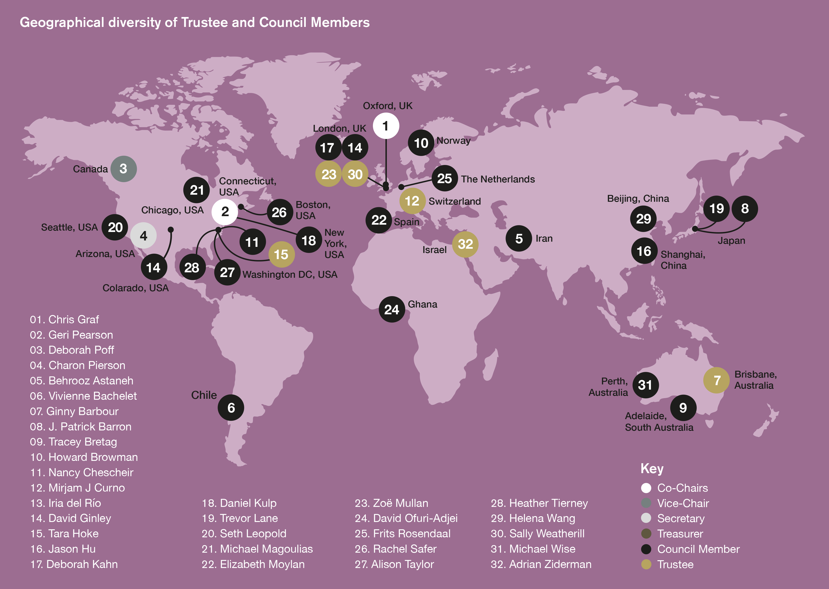

Slide 5
COPE’s Mission and Principles
COPE Mission
“Educate and advance knowledge in methods of safe-guarding the integrity of the scholarly record”
COPE Principles
Notes:
Integrity, Transparency, Professionalism is my spin on these

Slide 6
Centred Around Core Practices

Slide 8
COPE’s Core Practices
COPE assists editors of scholarly journals and publishers - as well as other parties, such as institutions - in their work to preserve and promote the integrity of the scholarly record through policies and practices. COPE describes these in 10 “Core Practices”. COPE's Core Practices should be considered alongside specific national and international codes of conduct for research.
https://publicationethics.org/core-practices

Slide 9
Centred around Core Practices
10 Core practices: https://publicationethics.org/core-practices
1. Allegations of Misconduct
Journals should have a clearly described process for handling allegations.
Journals must take seriously allegations of misconduct pre-publication and post-publication.
Policies should include how to handle allegations from whistleblowers.

Slide 10
Core Practices
2. Authorship and Contribution
Clear policies (that allow for transparency around who contributed to the work and in what capacity) should be in place for requirements for authorship and contributorship
Process for managing disputes

Slide 11
Core Practices
3. Complaints and Appeals
Should have a clearly described process for handling complaints against the journal, its staff, editorial board or publisher
Appeals process
4. Conflicts of Interest
Clear definitions of conflicts of interest and processes for handling it of authors, reviewers, editors, journals and publishers, whether identified before or after publication

Slide 12
Core Practices
5. Data and reproducibility
Policies on data availability and encourage the use of reporting guidelines and registration of clinical trials and other study designs according to standard practice in their discipline
Enhance reproducibility
6. Ethical oversight
Consent to publish, ethical use of animals, ethical studies involving human subjects, handling confidential data

Slide 13
Core Practices
7. Intellectual property
Policies on intellectual property, including copyright and publishing licenses, should be clearly described.
Any costs associated with publishing should be obvious to authors and readers.
Policies should be clear on what counts as prepublication that will preclude consideration.
What constitutes plagiarism and redundant/overlapping publication

Slide 14
Core Practices
8. Journal management
A well-described and implemented infrastructure is essential, including the business model, policies, processes and software for efficient running of an editorially independent journal, as well as the efficient management and training of editorial boards and editorial and publishing staff

Slide 15
Core Practices
9. Peer review processes
Must be transparently described and well managed.
Journals should provide training for editors and reviewers and have policies on diverse aspects of peer review, especially with respect to adoption of appropriate models of review and processes for handling conflicts of interest, appeals and disputes that may arise in peer review

Slide 16
Core Practices
10. Post-publication discussions, corrections
Journals must allow debate post publication either on their site, through letters to the editor, etc.
Must have mechanisms for correcting, revising or retracting articles after publication

