Slide 1
Innovations in publishing conference proceedings in Springer Nature
Aliaksandr Birukou
24 April 2018

Slide 2
Leading eBook Publishers: Total Number of eBooks
Total Number of English-Language eBooks (Aug 17)
English-Language eBooks published in 2016
Data from publisher websites; Taylor & Francis: numbers from CRCNetBase and T&F eBooks sites

Slide 3
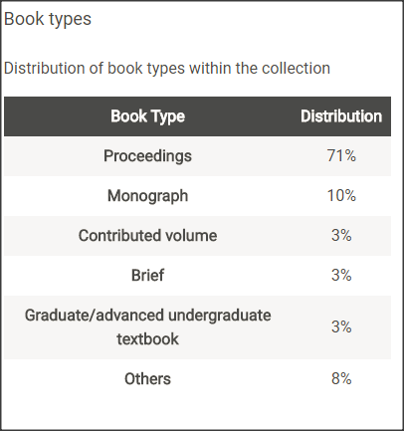
Proceedings in Springer by discipline - 2015
In certain fields scientists exchange their research via conferences
in Computer Science
12% of all Springer publications were Proceedings in 2015

Slide 4
Three facts about conference proceedings
1. CS publishes a significant portion of its research outputs as conference proceedings (63% in Scopus 2012-16)
3. 2 in top 5 most downloaded Springer Nature books in 2016 were proceedings
% Share of Conference Papers in All CS Papers 2012-2016 in various countries:
China – 52%
US – 65%
India – 71%
Germany – 74%
UK – 62%
.....
18. Russia – 68%
2. LNCS founding editors got ACM Distinguished Service Award for establishing CS as a subject

Slide 5
Implemented innovations – ready to use

Slide 6
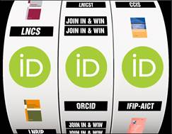
ORCID – win vouchers for Springer books
We started including ORCID for books and proceedings authors in early 2017
In order to increase the adoption of ORCID in CS proceedings, we will do a raffle
All authors who published with Springer in April-June 2018 and included their ORCID in the publication will be included in the prize draw
The prize draw will be done in July 2018
We are likely to repeat this for Q3 2018,
and done in Q4 2017 and Q1 2018
More at http://bit.ly/2H5xBpN

Slide 7
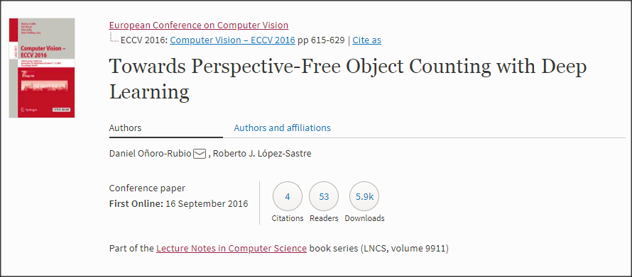
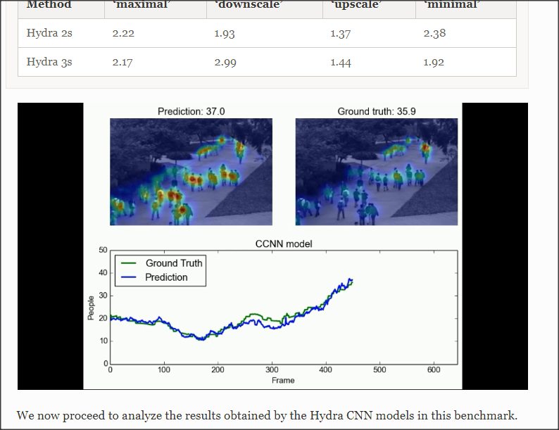
You can include videos in proceedings papers
More at: http://bit.ly/2xgOtCA

Slide 8
SharedIt for conference proceedings
Springer Nature wants researchers to share content easily and legally. Our Springer Nature SharedIt content-sharing initiative means that links to view-only, full-text subscription research articles can be posted anywhere - including on social media platforms, author websites and in institutional repositories - so researchers can share research with colleagues and general audiences.
https://www.springernature.com/sharedit
SharedIt was enabled in two proceedings series in 2017
~650 proceedings – with ~20,000 papers
SpringerLink subscribers can create links and share with
their colleagues, tweet, etc.

Slide 9
Advancing discovery via better metadata

Slide 10
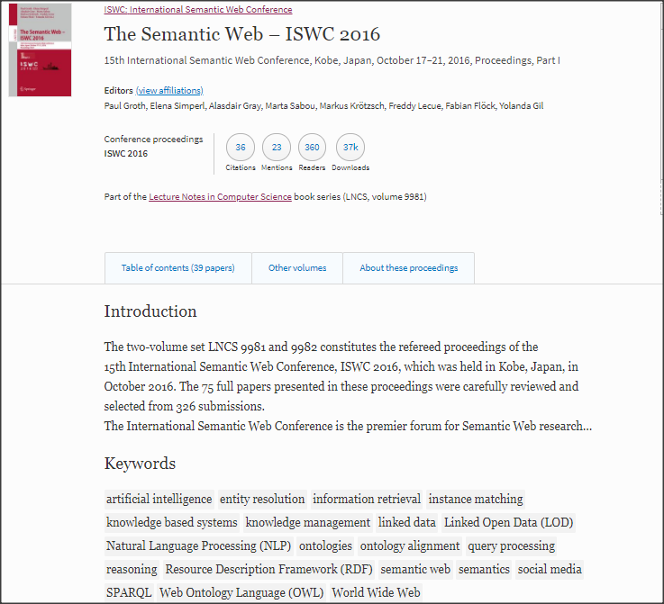
Proceedings classification in a nutshell
Notes:
Why – SEO, helps people to discover
HOW? see next slide

Slide 11
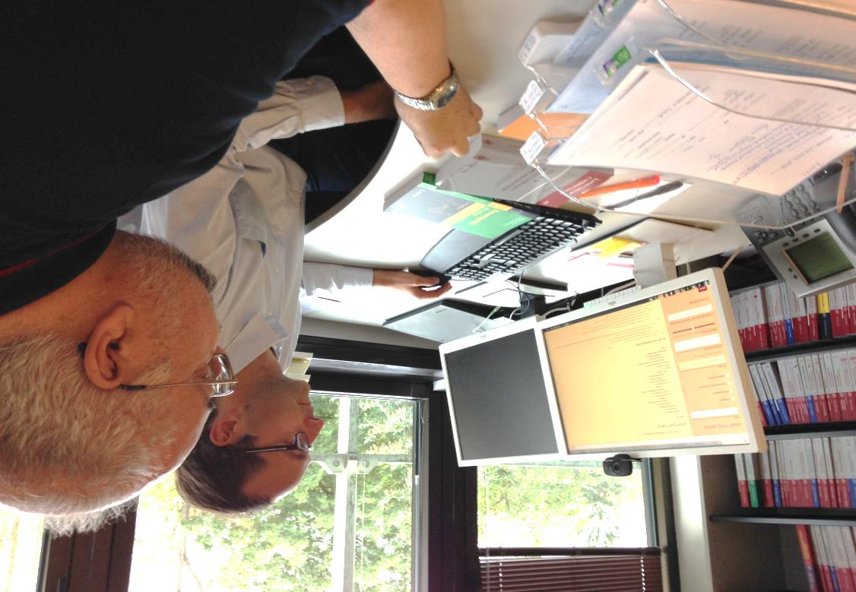
Classifying Scholarly publications
Traditionally, editors choose a list of related keywords and categories in relevant taxonomies using:
their own experience of similar conferences;
looking at titles and abstracts;
calls for papers.
Problems
manual effort, time-consuming
easy to miss new emerging topics
CfPs reflects “wishes” and not the reality

Slide 12
Computer Science Ontology (CSO) – automatically generated
Existing taxonomies / ontologies are not fine-grained enough and get obsolete very quickly
Open University, UK automatically generated a large-scale ontology with about 15,000 CS topics linked by about 70,000 relationships.
from 16 million publications
It included very granular research areas, e.g., Linked open data, Query answering, Synthetic aperture radar imaging
It can be regularly updated by running Klink-2 on a new set of publications.
Visit https://cso.kmi.open.ac.uk/home
Osborne, F. and Motta, E.: Klink-2: integrating multiple web sources to generate semantic topic networks. In ISWC 2015. (2015). Read for free at http://rdcu.be/wEKy

Slide 13
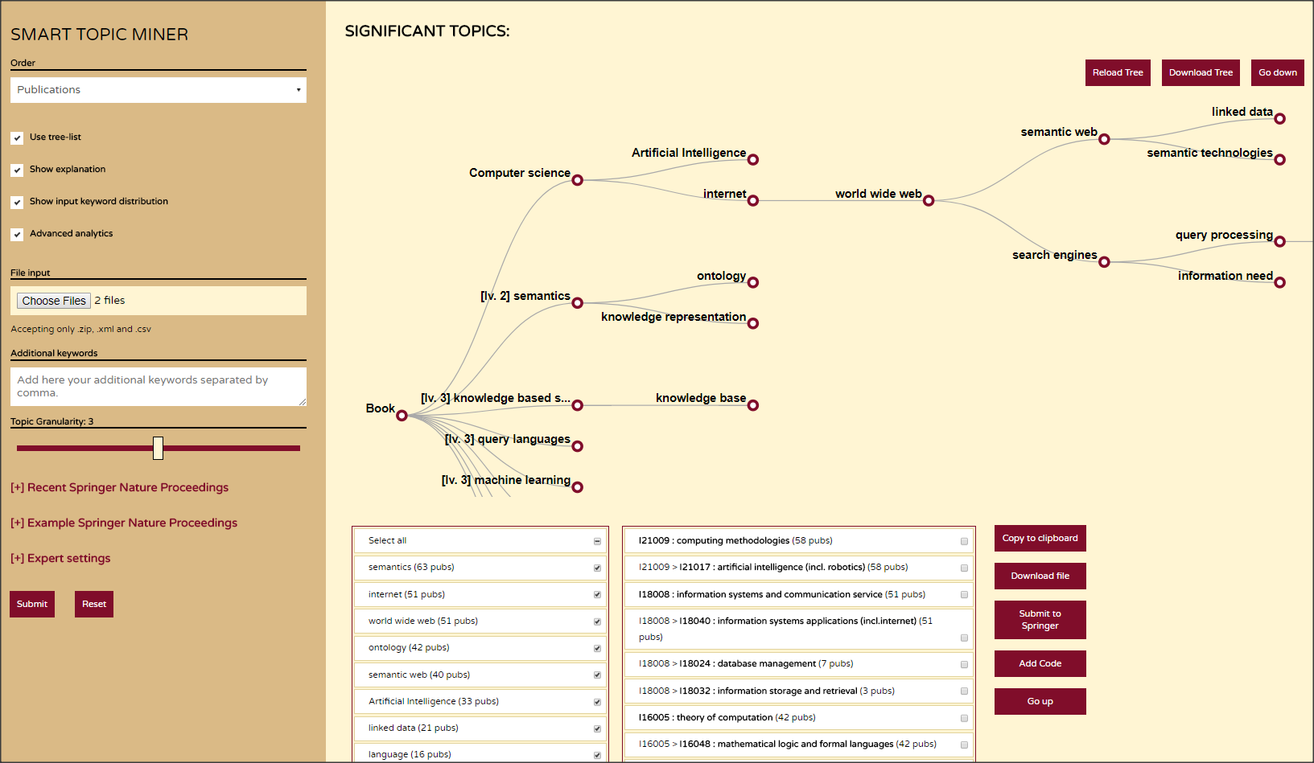
The Smart Topic Miner
The Smart Topic Miner (STM) is a semantic application designed to support the Springer Nature Computer Science editorial team in classifying scholarly publications.

Slide 14
STM at work. Topic extraction
The initial keywords are enriched with terms extracted from the publications and then mapped to a list of topics in the CS ontology;
Initial Keywords
(from authors and editors)
Enriched Keywords
(extracted from abstract, titles, etc)
CS Ontology topics
linked data:3, relational constraints:1, semantical regularizations:1, question answering:1, graph traversal:1, non-aggregation questions:1, implicit information:1, knowledge base completion:1, dbpedia:1, recommender system:1, relation extraction:1, weakly supervised:1, baidu encyclopedia:1, svm:1, path ranking:1, medical events:1, competitor mining:1, description logics:1, multi-strategy learning:1, distant supervision:1, relation reasoning:1, non-standard reasoning services:1, concept similarity measures:1, semantic data:1, medical guidelines:1, rdf:1, prolog:1, preference profile:1, similarity measure:1, ontology development:1, knowledge representation:1, graph simplification:1, rdf visualization:1, triple ranking:1, sparql-rank:1, rank-join operator:1, “shaowei” (稍微 ‘a little’):1, minimal degree adverb:1, a little:1, rdf native storage:1, news analysis:1, meta-data extraction:1, database integration:1, elderly nursing care:1 […]
semantic:24, rdf:7, applications:5, semantic web:5, knowledge base:4, linked data:4, ontology:4, ontologies:4, language:3, knowledge bases:3, algorithms:2, integration:2, architecture:2, semantics:2, knowledge management:2, query answering:2, recommendation:2, question answering system:2, semantic similarity:2, question answering:2, vocabulary:2, svm:1, graph traversal:1, information needs:1, path ranking:1, baidu encyclopedia:1, non-aggregation questions:1, support vector machine:1, implicit information:1, construction:1, knowledge base completion:1, relational constraints:1, semantical regularizations:1, support vector machine (svm):1, machine learning:1, support vector:1, facts:1, logic programming:1, multi-strategy learning:1, distant supervision:1, competitor mining:1, lossy compression:1, comprehensive evaluation:1, relation reasoning:1, websites:1, competition:1, decision support:1, learning algorithm:1 […]
(1) Computer Science [21]
--- (2) Internet [18]
-------- (3) World wide web [16]
------------- (4) Semantic web [16]
------------------ (5) Rdf [7]
------------------ (5) Linked data [5]
---------- (3) NLP systems [3]
--------------- (4) Question answering [2]
---------- (3) Recommender systems [2]
--- (2) Artificial intelligence [12]
-------- (3) Knowledge based systems [8]
------------- (4) Knowledge representation [4]
------------------ (5) Description logic [3]
-------- (3) Machine learning [4]
(1) Semantics [24]
--- (2) Ontology [10]
--- (2) Metadata [7]
-------- (3) Rdf [7]
--- (2) Semantic web [16]
(1) Language [5]
--- (2) Vocabulary [2] […]
Notes:
http://rexplore.kmi.open.ac.uk/STM_demo

Slide 15
Ongoing innovation pilots

Slide 16
Data publishing

Slide 17
How interested are authors in a service that helps them to deposit their data in a repository?
Responses from Springer Nature author survey
How important is data discoverability to authors?
Total respondents = 7656

Slide 18
Introducing Springer Nature Research Data Support
To help researchers follow good practice in sharing and archiving of research data, we’re now offering optional data deposition and curation services.
Researchers submit their data files securely
The Research Data team curates the data and metadata
The data are published
More information is available on our website here:
http://go.nature.com/ResearchDataServices

Slide 19
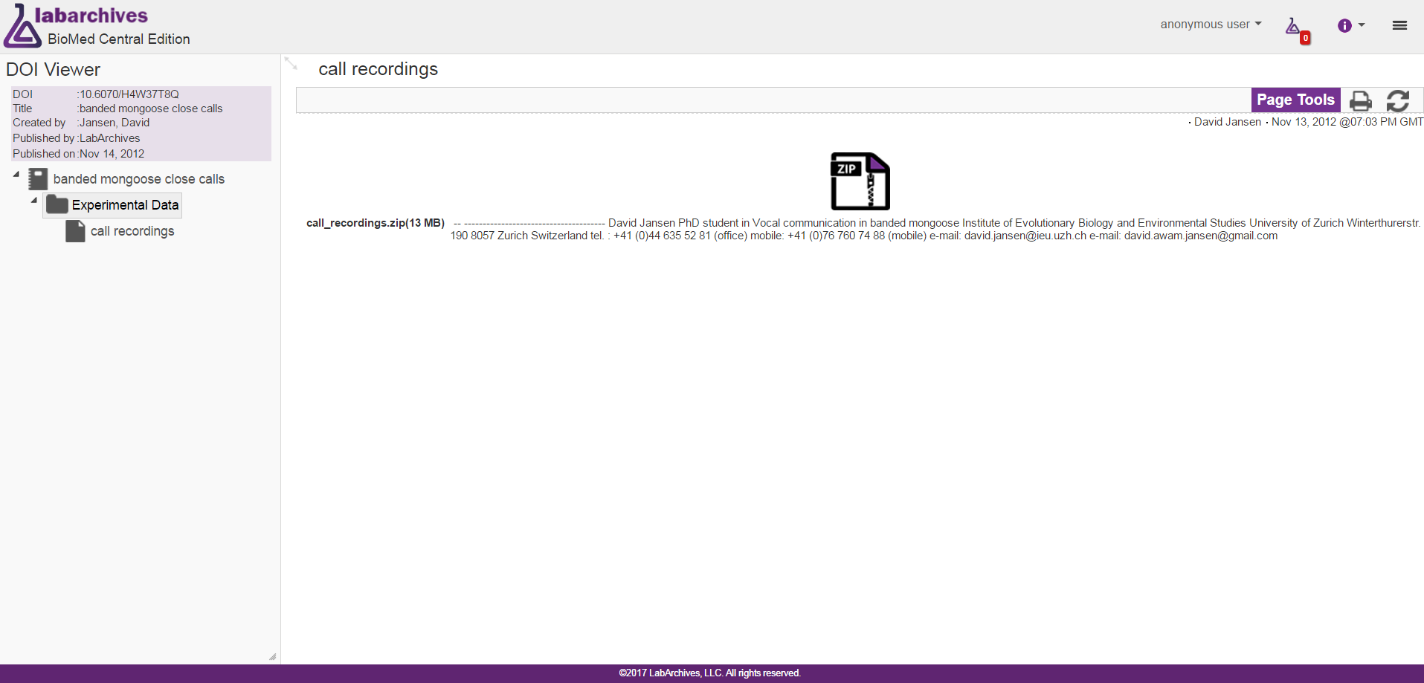
Before editing – researcher’s electronic lab notebook

Slide 20
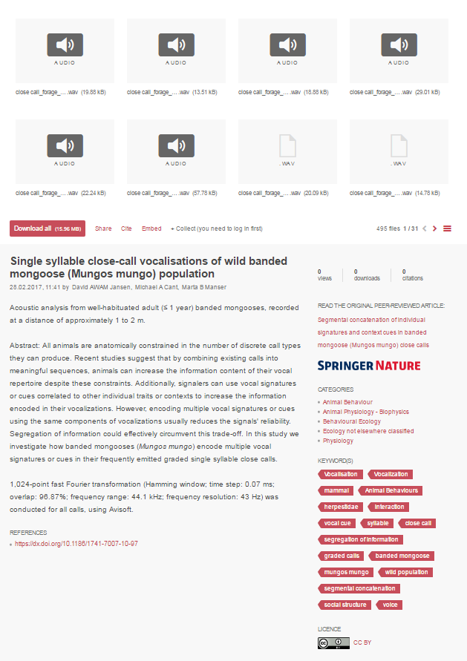
After data curation
Now includes
Link to associated, peer-reviewed publication
Consistent titles and author names
Clear citation information
Files preview-able in browser
Metadata for each file in the archive
Contextual information
Clear license/terms of use
Dataset description/abstract
Rich usage statistics

Slide 21
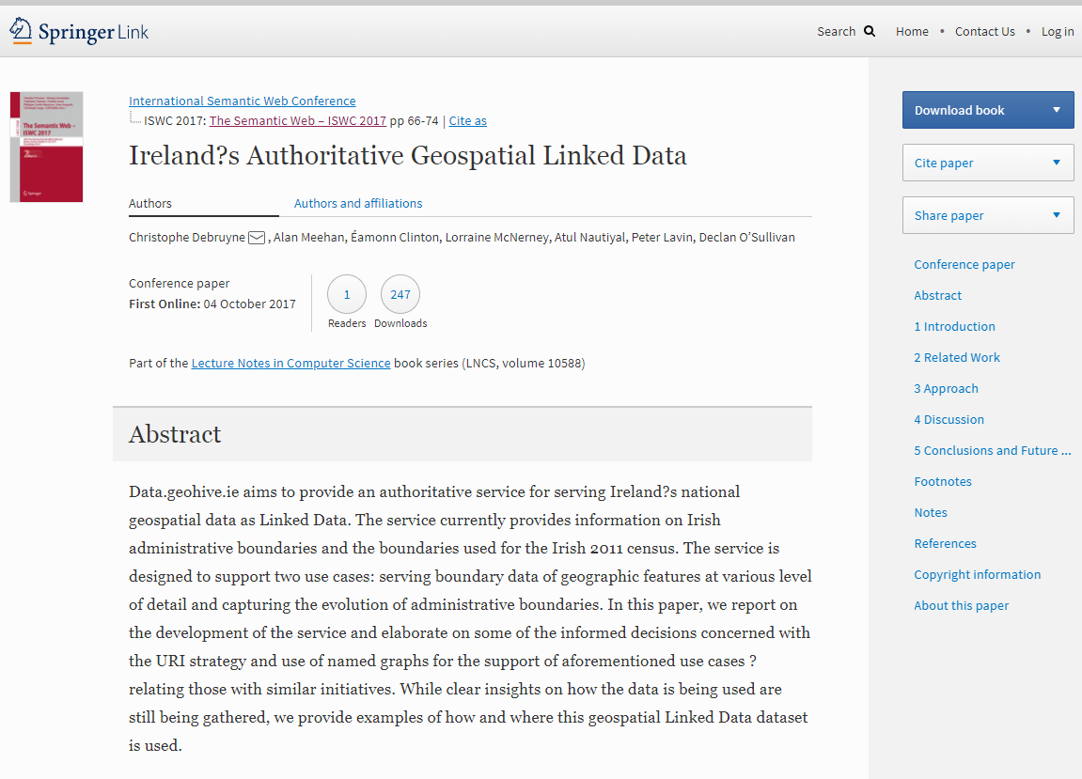
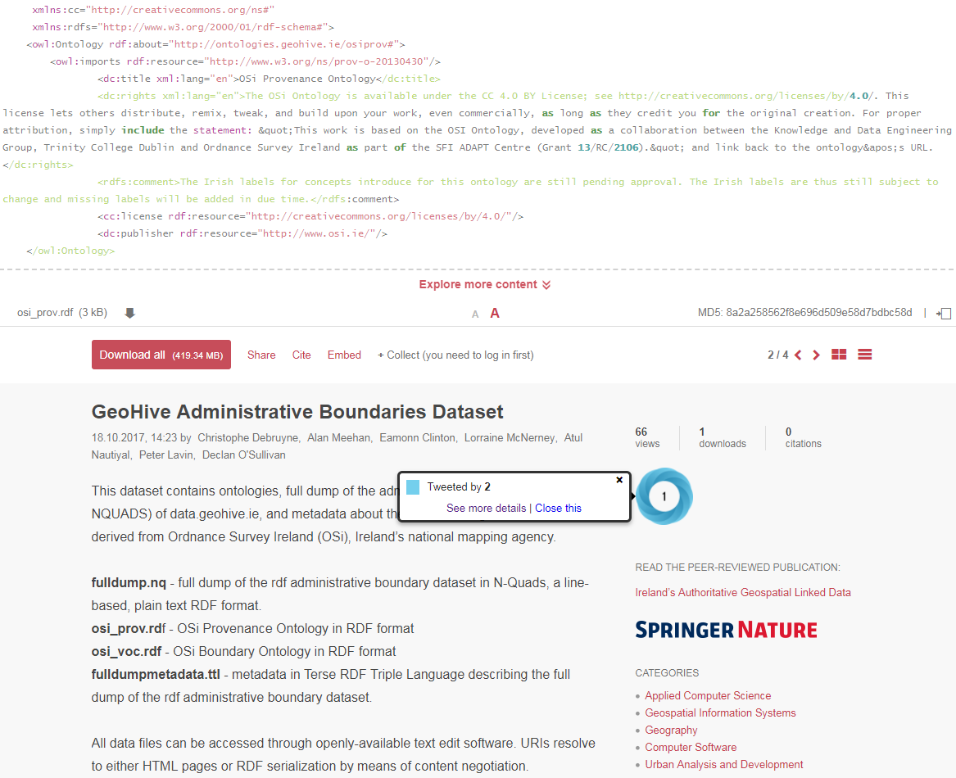
Example output for ISWC 2017
The data on Figshare links to the published paper
The paper will also link to the data on Figshare and have a proper data citation.

Slide 22
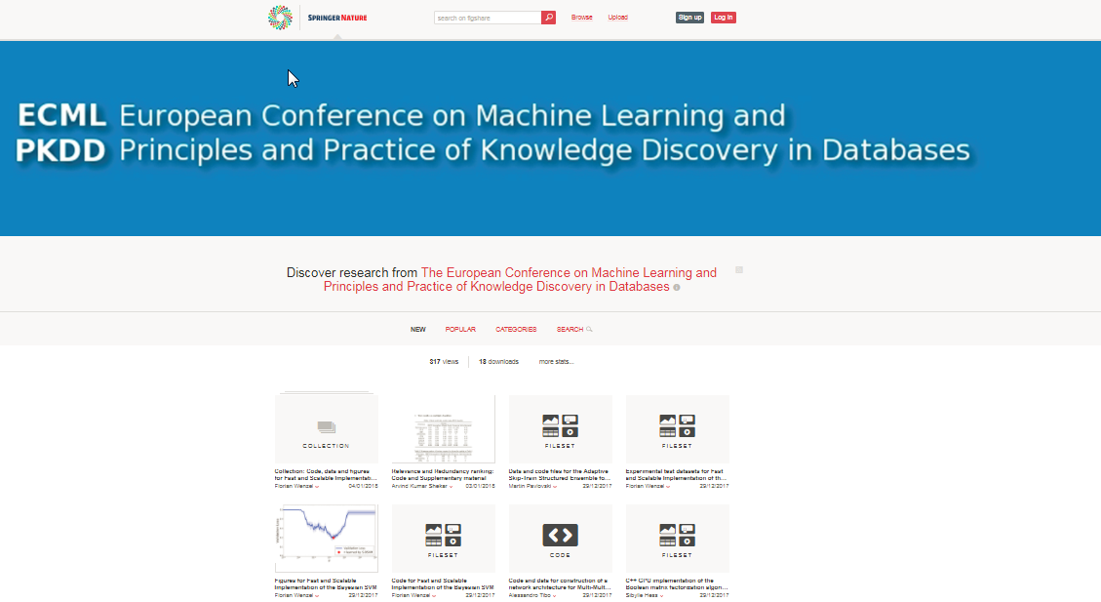
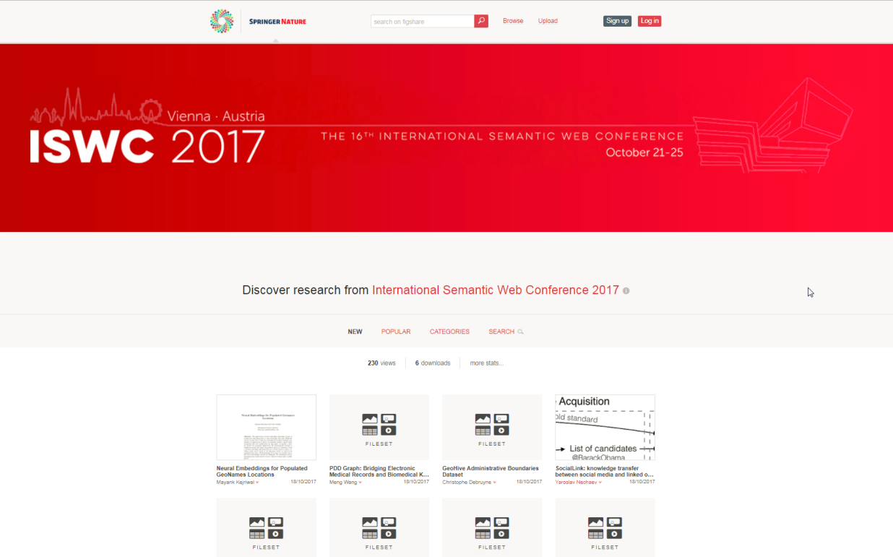
Pilots in 2017
October 2017: ISWC 2017 https://springernature.figshare.com/semweb - 11 datasets
December 2017: ECML PKDD 2017 – https://springernature.figshare.com/ecml - 11 datasets

Slide 23
More conferences in 2018
April 2018: TACAS 2018 https://springernature.figshare.com/tacas - 21 datasets
August 2018: Euro-Par 2018 – https://europar2018.org/ - ongoing
Both conferences participate in the Artifact Evaluation initiative
...2-3 more conferences might join

Slide 24
Persistent IDs for conferences

Slide 25
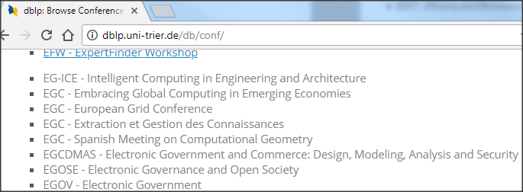
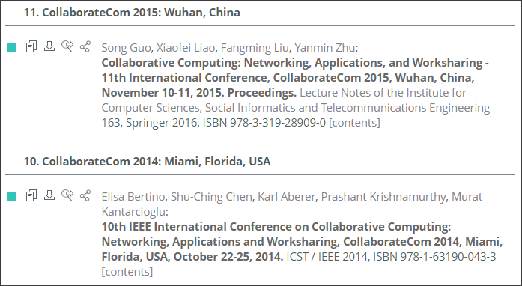
We started by helping Google Scholar
Conference acronyms are not unique
Conferences change publishers
There are fake / mock conferences

Slide 26
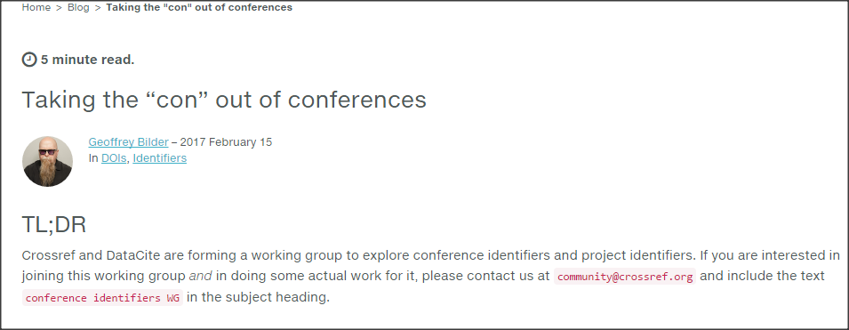
CrossRef working group
Scope of the group:
(1) Unique Conference IDs
(2) Metadata on peer-review process
all data will be available under CC0
Notes:
Crossref board meeting was held in November 2016. The idea of a unique cross-publisher ConferenceSeriesID and a CrossMark for proceedings was well received. Crossref will build a technical working group.

Slide 27
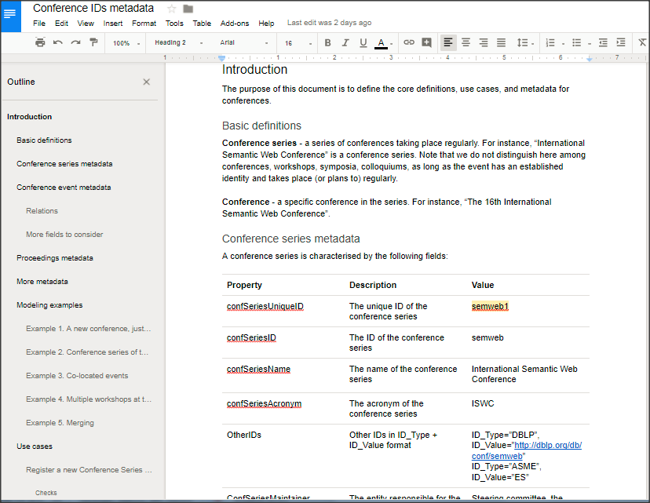
Metadata for conferences: open for comments till end of May 2018
see Crossref blog and twitter #confpid
https://www.crossref.org/blog/pids-for-conferences---your-comments-are-welcome/

Slide 28
Innovations in peer review
See more in 2017 talk

Slide 29
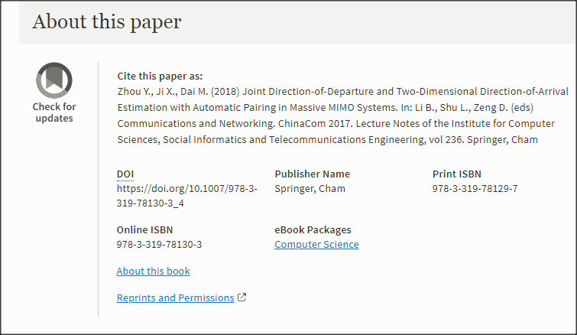
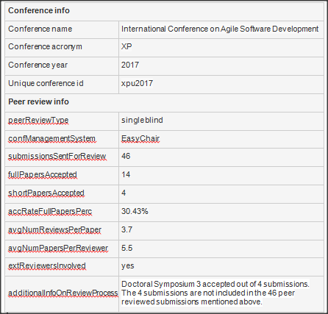
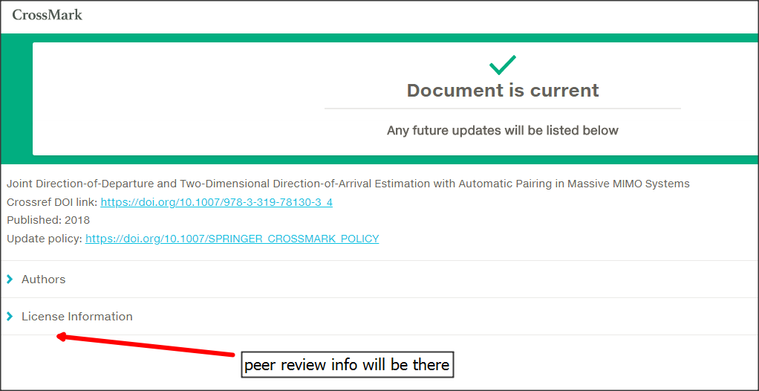
Crossmark for proceedings

Slide 30
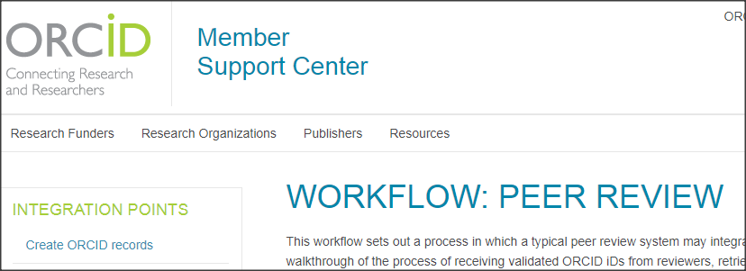
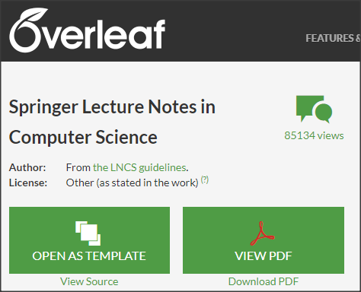
More innovations
Pilot with ORCID to recognize conference peer reviewers
Pilot with Overleaf for submitting conference papers directly from Overleaf
Linked Open Data about conference proceedings in SciGraph

Slide 31
Большое спасибо за внимание!
Thanks to my colleagues who helped me to prepare these slides:
Iain Hrynaszkiewicz
Heather King
Viktoria Meyer
Francesco Osborne
Jeffrey Robbens
Follow me at @birukou, @liquidpub, @SpringerCompSci
Subscribe to updates on #confpid
Ну забудьте посетить

