Slide 1
Getting Indexed in International Scientific Citation Databases: Current Trends and Common Gaps
Tuesday, April 24, 2018
Dr Andreas Thoss
@enago
academy@enago.com
enagoacademy
Enago

Slide 2
About Dr Andreas Thoss
Editor & Publisher for Advanced Optical Technologies
Founder, Thoss Media GmbH
Ex-Publisher, John Wiley & Sons
Ex-Director, JenLab GmbH
Contributing Editor, Laser Focus World
Helped establish Laser & Photonics Reviews and Journal of Biophotonics
Associated with Optical Society of America & Society of Photographic Instrumentation Engineers for training workshops

Slide 3
About Enago
https://www.enago.com
Since 2005, Enago has assisted ESL researchers to improve the communication of their research and helped them get published.
Enago is a strategic services partner for 350+ Universities, 30+ STM publishers, 600+ academic Journals.
Enago provides language editing, academic translation, publication support, and author education services.
Enago is headquartered in US with regional offices in Japan, Korea, China, Taiwan, Turkey, UK, Germany, Brazil, Colombia and Canada.

Slide 4
Agenda
About Russian research output and impact
Current publishing trends in Russia
Common/critical challenges for Russian journals
Case studies of Russian journals
Best practices for indexing
Solutions
Predatory journals/publishers
Takeaway points
Questions & Answers

Slide 5
Russian Research Output and Impact
Copyright © 2018 Enago Academy | All Rights Reserved.
Notes:
Russian example

Slide 6
Russian R&D and Funding
In Russia, ~3,500 organizations are currently engaged in R&D, of which 70% belong to the state.
Based on 2013 data published in Science, Nature and PNAS, the Russian funding sources were
Russian Science Foundation - 60 publications
Russian Foundation for Basic Research - 51 publications
Russian Ministry of Education and Science - 28 publications
Copyright © 2018 Enago Academy | All Rights Reserved.
Notes:
Sources: i) https://www.stm-assoc.org/2015_02_20_STM_Report_2015.pdf, ii) http://russiatrek.org/about-russian-science, and iii) http://news.ifmo.ru/en/archive/news/5867/

Slide 7
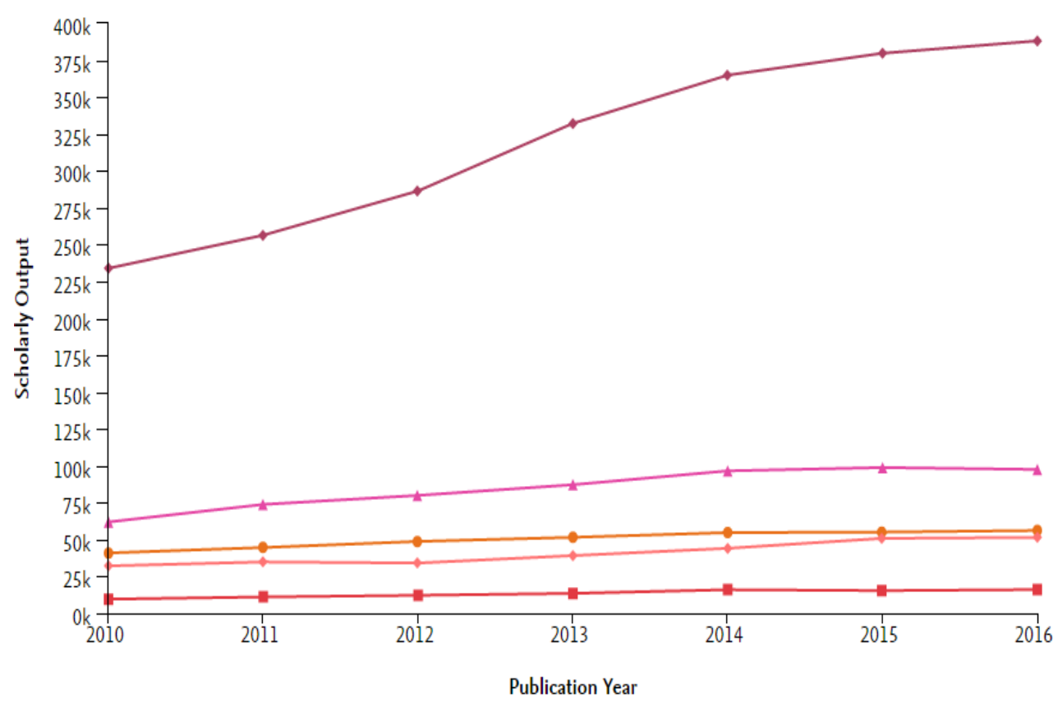
Scholarly Output and Impact
Figure: Scholarly output originating from Russia compared to that of other countries. Source: Shareef Bhailal, Scopus Content Overview, April 2017.
Notes:
http://conf.neicon.ru/materials/28-Sem0417/170417_0900_Bhailal.pdf
The figure represents the growth in the number of publications originating from different countries between 2010 and 2016. Based on the data, the output from Russia seems lesser or close to that from Brazil.

Slide 8
Russian Research in 2018
The Russian government will allocate 170 billion roubles (US$3 billion) for R&D, an increase of 25% over last year’s budget.
The Russian Science Foundation will allocate US$392 mln in grants to researchers.
Among projects supported by RSF, projects in biology, agriculture, fundamental medicine is now >25%.
As US NSF’s January 2018 data, Russia is ahead of Canada, Australia, and Switzerland in terms of number of published articles.
As of January 2018, Russian Academy of Sciences has identified that >25% of academic institutes were “underperforming” in terms of publications, citations, and patents.
Copyright © 2018 Enago Academy | All Rights Reserved.
Notes:
Source:
https://www.nature.com/articles/d41586-018-02872-8
http://rscf.ru/en/node/2902
From 2006 to 2016, the number of papers produced in Russia more than doubled; this growth in papers from Russia was higher than that from both Brazil and South Korea. Accordingly, the Russian government has made an aggressive plan for Russian science in 2018. The share of projects in biology, agriculture, fundamental medicine among the projects supported by the Russian Science Foundation is >25%.

Slide 9
Current Publishing Trends in Russia
Copyright © 2018 Enago Academy | All Rights Reserved.

Slide 10
Issues Noted in Russian Journals
Plagiarism in Russian papers continues to be detected by both reviewers and journal editors
Plagiarism in research grant applications still goes unnoticed by most research evaluators.
Some Russian scholarly journals do not follow a standardized peer review process.
Copyright © 2018 Enago Academy | All Rights Reserved.
Notes:
Sources:
https://www.ncbi.nlm.nih.gov/pmc/articles/PMC4009718/
http://www.ease.org.uk/wp-content/uploads/2015/12/Current-state-of-science-editing-and-publishing-in-Russia.pdf
Regardless of the previous growth numbers, certain challenges continue to plague the Russian publishing industry and science. For instance, only 1 in 10 publications of Russian authors is indexed by international databases.

Slide 11
Coverage of Russian Journals
Russian Index of Scientific Citations (http://elibrary.ru/) does not strictly calculate research performance indicators
Russian science, particularly in social sciences and humanities, is poorly covered by international databases.
The best Russian journals were found to be those in physics, astronomy and chemistry.
Russian publications covered by WoS grew from ~150 in 2009 to >230 in early 2017.
The highest number of Russian journals are listed in SCIE (157), followed by AHCI (7), and SSCI (5).
WoS does not have any Russian journal in economics, political science or arts.
Copyright © 2018 Enago Academy | All Rights Reserved.
Notes:
Sources:
http://www.ease.org.uk/wp-content/uploads/2015/12/Current-state-of-science-editing-and-publishing-in-Russia.pdf
https://elibrary.ru/publishers.asp
https://herb.hse.ru/data/2017/03/05/1166793604/1HERB_11_view.pdf
Abbreviations:
SCIE – Science Citation Index Expanded
AHCI – Arts and Humanities Citation Index
SSCI – Social Sciences Citation Index
Also, there has been a growth in the number of Russian journals indexed by WoS; however, most journals continue to get indexed by SCIE, followed by AHCI and SSCI. The indexing in Scopus for Russian journals is better (300 vs 230 for WoS).

Slide 12
Highlights for Russian Journals
In Scopus, there are 300 indexed Russian journals:
i) physical sciences – 181,
ii) life sciences – 44,
iii) health sciences – 42,
iv) social sciences – 16,
v) physics and astronomy – 2.
Although Chinese research is 8 times that of Russia, China has only ~260 journals in the WoS.
Russian Chemical Reviews, Physics-Uspekhi, and Russian Mathematical Surveys are part of the top 25% of high impact factor journals.
Polymer Science Series C and Moscow Mathematical Journal are in the top 50% of high impact factor journals for their respective research areas.
Copyright © 2018 Enago Academy | All Rights Reserved.
Notes:
Sources:
https://images.webofknowledge.com/WOKRS520B4.1/help/RSCI/hp_whatsnew_rsci.html
https://herb.hse.ru/data/2016/03/03/1125173577/1HERB_07_view.pdf or https://www.hse.ru/en/news/research/177568491.html
http://europeanscienceediting.eu/wp-content/uploads/2016/08/ESEAug16origarticle.pdf

Slide 13
Survey for Russian Journals
In a 2013 survey (sample size: 100) conducted by a group of Russian researchers (Gorin et al.), the following opinions for Russian science journals were obtained:
65% of respondents considered Russian journals do not have a reputation, while 35% thought that these journals are not highly regarded.
Respondents did not always trust information from Russian journals
Articles were of low quality and journal design was poor.
Journal’s reputation to be directly related to the quality of scientific articles.
The Journal Impact Factor, founding body and social responsibility were judged as secondary factors.
Source: Gorin et al. Current state of science editing and publishing in Russia. European Science Editing. 2013, 39(4): 87-89.
Copyright © 2018 Enago Academy | All Rights Reserved.
Notes:
Source: http://www.ease.org.uk/wp-content/uploads/2015/12/Current-state-of-science-editing-and-publishing-in-Russia.pdf

Slide 14
Common/Critical Challenges
for Russian Journals
Copyright © 2018 Enago Academy | All Rights Reserved.

Slide 15
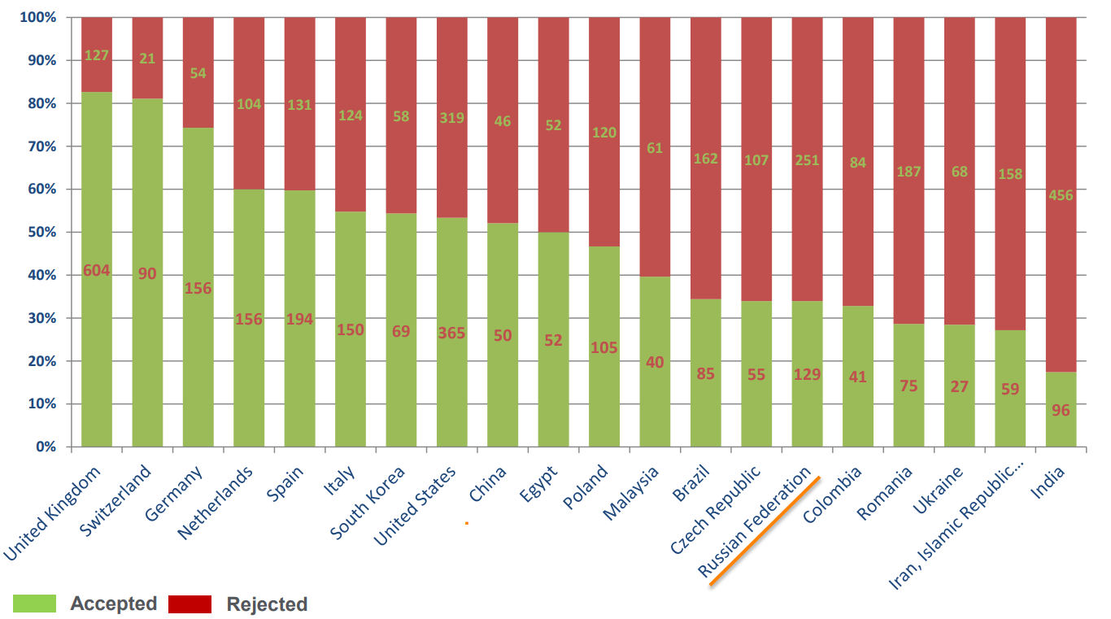
Some Facts
Figure: Based on data from Scopus, <33% of Russian journals get indexed after review
Indexing in Scopus
Copyright © 2018 Enago Academy | All Rights Reserved.
Notes:
Source:
http://conf.neicon.ru/materials/28-Sem0417/170417_0900_Bhailal.pdf

Slide 16
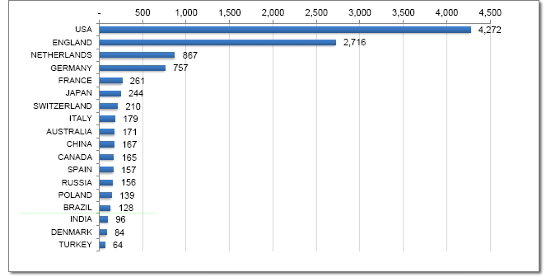
Some Facts (…contd)
Indexing in Web of Science
Figure: Based on 2013 data, 156 Russian journals were indexed by WoS. Source: 2nd Asian Science Editors' Conference & Workshop, August 2015.
Copyright © 2018 Enago Academy | All Rights Reserved.
Notes:
Source:
https://www.asianeditor.org/event/2015/workshop7/4.How%20to%20add%20Journal.pdf
In 2013, the number of Russian journals getting indexed in WoS was <200.

Slide 17
Important Changes
Changes to the publishing market
(e.g., open access publishing, sales models such as consortia licensing, globalisation and the growth of new regions)
Changes to the way research is conducted
(e.g., growth of data-intensive and data-driven science)
Changes to public policy
(e.g. research funder self-archiving and data-sharing mandates)
Copyright © 2018 Enago Academy | All Rights Reserved.
Notes:
Source:
https://www.stm-assoc.org/2015_02_20_STM_Report_2015.pdf
In the last two decades, the licensing model of academic publishers has been challenged with the changes to public policy, research methodology, and overall expectations from journal’s audience and users.

Slide 18
Primary Challenges
Russian publications are rarely cited in English language papers.
Articles published in Russian journals cannot be captured by citation management systems.
Some journals still use PDF files of the complete issue rather than provide links for each article.
Users are unable to perform contextual search for a Russian article’s content on search engines.
Russian journals need to improve indexing of their online information by search engines and citation managers.
Copyright © 2018 Enago Academy | All Rights Reserved.
Notes:
Source:
https://www.ncbi.nlm.nih.gov/pubmed/26639728
The major gaps for Russian publications is i) lack of publications in English, ii) citation management systems not capturing citation data, iii) journals not providing individual links to research articles, iv) indexing on search engines and citation managers is less. These issues are both directly or indirectly related to digitization of Russian journals too.

Slide 19
Primary Challenges (…contd)
Russian journals need to increase digital presence of content by including
i) digital object identifiers (DOIs),
ii) XML encoding for archiving and preserving literature, and
iii) indexing and posting journal articles on digital platforms
Reputed researchers are cautious to submit to journals that do not have a clear peer review or indexing process.
Most Russian scholarly journals remain largely unknown to the global scientific community, causing isolation of research published in Russian journals.
Copyright © 2018 Enago Academy | All Rights Reserved.
Notes:
Source:
https://www.ncbi.nlm.nih.gov/pubmed/26639728 and https://www.ncbi.nlm.nih.gov/pmc/articles/PMC4009718/
http://www.ease.org.uk/wp-content/uploads/kiselevesenov12.pdf
The drive to digitize Russian journals has been considerably less compared to that for other international journals, there continue to be issues with DOIs, XML encoding, and indexing on digital platforms. Also, the peer review process that is followed is quite unclear, so researchers are cautious to submit to Russian journals. In fact, most Russian journals are unknown to the scientific community, which leads to isolation of research published in Russian journals.

Slide 20
Other Limitations
English language skills among Russian authors and editors limit the global influence of their scientific articles.
Although Russian journals have launched English language versions, very few of them are pursuing a bilingual model.
Certain common issues that persist among Russian journals:
lack of electronic full-texts of articles,
poor quality of journal websites,
inefficient peer review,
lack of funds to run the journals, and
incorrect English language review (for bilingual journals).
Copyright © 2018 Enago Academy | All Rights Reserved.
Notes:
Source: http://www.ease.org.uk/wp-content/uploads/kiselevesenov12.pdf
The lack of English skills prevents publication of good articles that are written in English by Russian journals. Also, we have listed some common issues for Russian publications such as inefficient peer review, lack of funds, and incorrect English language review (acceptance of poorly written scientific articles) whose solutions will be discussed later in this session.

Slide 21
Solution: Follow These Best Practices
to Get Indexed
Copyright © 2018 Enago Academy | All Rights Reserved.

Slide 22
Getting Indexed
Using Journal Hosting Systems
Hosting systems assist in publication of scholarly content like journals, articles, or books
These systems help editors have real-time interactions with authors/peer reviewers
Easy verification and tracking of identifiers like DOIs, ORCID, CrossRef, ISBNs, etc
Using Aggregators
Aggregators like JSTOR, SciELO, and Redalyc offer free access to scholarly material and virtually act as digital libraries
They also act like bibliographic databases
Copyright © 2018 Enago Academy | All Rights Reserved.
Notes:
Source:
https://www.highwirepress.com/why-us
https://www.atypon.com/who-we-are/company/
https://www.silverchair.com/the-silverchair-platform/
https://about.jstor.org/
http://www.scielo.br/
http://www.redalyc.org/redalyc/media/redalyc_n/Estaticas3/mision.html

Slide 23
Indexing in Google Scholar
Unlike Scopus or WoS, Google Scholar does not have any submission process for journals/publishers.
GS uses crawlers (automated bots) for indexing, so following practices are recommended:
Journal Publishers
For a small number of journals, established journal hosting services should be used such as Atypon and Highwire.
If aggregators like JSTOR or SciELO are used, then they should support full-text indexing in Google Scholar.
University Repositories
Google Scholar recommends using the latest version of Eprints, Digital Commons, or DSpace software to host your papers.
Google Scholar also recommends using Open Journal Systems (OJS)
Copyright © 2018 Enago Academy | All Rights Reserved.
Notes:
Source:
https://www.sciencedirect.com/science/article/pii/S1751157715300900
Google Scholar has a very different nature than WoS and Scopus. The coverage of Google Scholar is also unclear. As a search engine, Google Scholar needs very limited bibliographic meta data on publications. Google Scholar indexes publications in journals, conference proceedings, books, theses, preprints, and technical reports.
Recently, in a published study, Google Scholar was reported to index ~100 million English-language documents, i.e., almost 87% of all English-language scholarly documents available on the web. If non-English documents are included, the number was ~160 million.
Source:
https://scholar.google.co.in/intl/en/scholar/inclusion.html
Eprints (eprints.org), ii) Digital Commons (digitalcommons.bepress.com), or iii) DSpace (dspace.org)

Slide 24
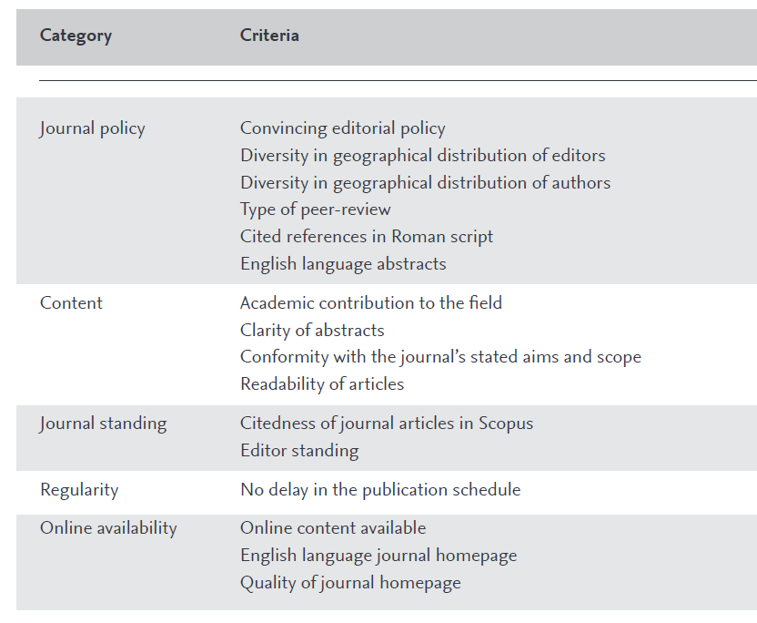
Indexing in Scopus
Figure: Criteria for getting indexed by Scopus
Notes:
Source: https://www.elsevier.com/__data/assets/pdf_file/0007/69451/0597-Scopus-Content-Coverage-Guide-US-LETTER-v4-HI-singles-no-ticks.pdf
All journals that are submitted for evaluation should be the following primary criteria for review:
All content has to be peer-reviewed
Issues should be published on a regular basis
Journal should have an ISSN number registered with the International ISSN Centre
Content should be relevant and readable for an international audience (e.g., references in Roman script and English language abstracts and titles)
Have a publication ethics and publication malpractice statement
The criteria that will be used in the review process are grouped in five main categories: journal policy, content, citations, regularity and online availability.
The subject matter experts of CSAB then review titles using both quantitative and qualitative measures, and the selection is partly based on sample documents from the title.

Slide 25
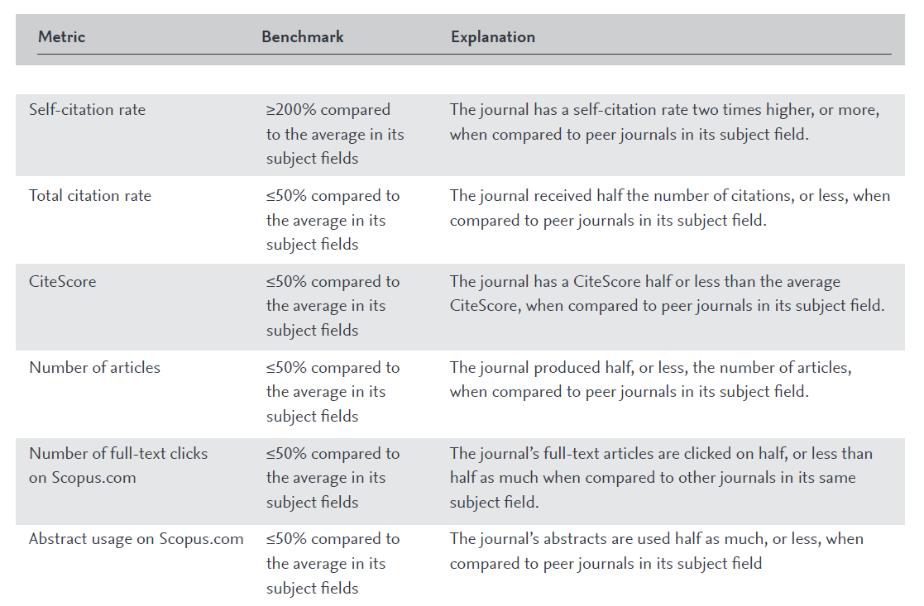
Best Practices for Scopus - 2
Indexing in Scopus
Figure: Re-evaluation criteria of Scopus for indexed journals.
Notes:
Source: https://www.elsevier.com/__data/assets/pdf_file/0007/69451/0597-Scopus-Content-Coverage-Guide-US-LETTER-v4-HI-singles-no-ticks.pdf
Journals tend to alter editorial policies, publishing standards, and underperform over time. However, SCOPUS incentivizes journals to maintain their high content quality by annually re-evaluating low-performing journals based on
Self-citation rate
Total citation rate
CiteScore
Number of published articles
Number of full-text articles
Usage of abstracts on Scopus

Slide 26
Indexing in WoS
If number of publications in Scopus are compared with those in WoS, 97% of publications covered by WoS are covered by Scopus; hence, WoS is almost a perfect subset of Scopus.
3,500 journal titles for inclusion in SCIE, SSCI and AHCI, only ~10% of these journals are accepted for coverage by WoS.
Along with SCIE, SSCI, and AHCI, WoS has developed the Emerging Sources Citation Index (ESCI), a multidisciplinary citation index covering all areas of sciences, social sciences and arts & humanities.
Copyright © 2018 Enago Academy | All Rights Reserved.
Notes:
Source:
https://www.sciencedirect.com/science/article/pii/S1751157715300900
https://clarivate.com/essays/journal-selection-process/
The selection process for all WoS indices is the same.

Slide 27
Indexing in WoS (…contd)
Journals accepted for coverage in ESCI must be
peer reviewed,
follow ethical publishing practices,
meet WoS’s technical requirements,
have English language bibliographic information, and
be recommended or requested by a scholarly audience of Web of Science users.
Journals in ESCI may be evaluated later for coverage in SCIE, SSCI or AHCI.
Coverage in ESCI does not guarantee eventual acceptance into SCIE, SSCI or AHCI.
Copyright © 2018 Enago Academy | All Rights Reserved.
Notes:
Source:
https://www.sciencedirect.com/science/article/pii/S1751157715300900
https://clarivate.com/essays/journal-selection-process/

Slide 28
Indexing in WoS (…contd)
Journal Impact Factor metrics are not calculated for journals covered in ESCI.
Only journals selected for SCIE and SSCI are assigned the JIF and related metrics.
For JIF, the metrics are drawn from SCIE, SSCI, AHCI, ESCI, and the Conference Proceedings Citation Index (CPCI).
JIFs are not calculated for journals covered only in AHCI.
Copyright © 2018 Enago Academy | All Rights Reserved.
Notes:
Source:
https://www.sciencedirect.com/science/article/pii/S1751157715300900
https://clarivate.com/essays/journal-selection-process/

Slide 29
What is CrossRef?
CrossRef’s tools and services allows identification, citations, linking, and verification of publications.
Publications include
Journals and journal articles
Books and book chapters
Conference proceedings
Technical reports
Preprints
Theses and dissertations
CrossRef helps readers follow DOI links from reference lists and locate the source from a member’s publishing platform.
CrossRef has >10,000 members from >100 countries.
Copyright © 2018 Enago Academy | All Rights Reserved.
Notes:
Source:
https://www.crossref.org/get-started/
https://www.crossref.org/membership/small-publishers/

Slide 30
Indexing in CrossRef
CrossRef requires journals to send their metadata and assign persistent identifiers (DOIs, ORCIDs, etc) to their content.
CrossRef also requires usage of DOIs with the prefix for the DOI being unique to each journal.
All members should also have their own registration XML, which gets validated by CrossRef.
Figure: DOI formats used by CrossRef
Copyright © 2018 Enago Academy | All Rights Reserved.
Notes:
Source:
https://www.crossref.org/get-started/
https://www.crossref.org/get-started/content-registration/
Journals are required to share bibliographic metadata as well as funding data, reference lists, abstracts, and ORCIDs, and similar information. This sharing has to be on a regular basis and tracked by including persistent identifies like DOIs, ORCIDs, etc. The XML upload is critical for ensuring that the published links are actually working.

Slide 31
Indexing in CrossRef (…contd)
CrossRef requires members to follow specific guidelines for DOIs and display them at different instances:
Tables of contents
Abstracts
Within HTML or PDF articles
When downloading citations to reference management systems
“How to Cite This” instructions on content pages
Whenever directing users to a permanent, stable, or persistent link
CrossRef also maintains a funder registry (FundRef), which is a unique list of grant-providing agencies/organizations.
Copyright © 2018 Enago Academy | All Rights Reserved.
Notes:
Source:
https://www.crossref.org/get-started/

Slide 32
Solutions for Journals & Publishers
Copyright © 2018 Enago Academy | All Rights Reserved.

Slide 33
Indexing Requirements - 1
Timelines
For WoS indexing, new journals that publish regularly will be considered after three consecutive issues are published.
If journals publish individual articles, WoS will take ~9 months to check their status.
Document type
For excluding publications from indexing in either WoS or Scopus, the publication type is a very common factor.
For indexing, all publications should have a type such as
article,
review,
letter,
editorial material,
meeting abstract,
or proceedings paper
Copyright © 2018 Enago Academy | All Rights Reserved.
Notes:
Source:
https://www.sciencedirect.com/science/article/pii/S1751157715300900
https://clarivate.com/essays/journal-selection-process/

Slide 34
Indexing Requirements - 2
Quality of language
Publications are also excluded because of the language in which they are written.
Non-English language publications have been reported to receive fewer citations (on average) than English language publications.
Most researchers cannot read publications that are not in English.
Avoiding self-citations
At the journal level (i.e., journal’s publication citing another publication of the same journal)
At institutional level (i.e., a publication of an institution citing another publication of the same institution)
At the author level (i.e., at least one author is common)
Copyright © 2018 Enago Academy | All Rights Reserved.
Notes:
Source:
https://www.sciencedirect.com/science/article/pii/S1751157715300900
https://clarivate.com/essays/journal-selection-process/
By author level self-citations, it means that the paper that is getting published has a citation of either the author or co-authors of the published study.

Slide 35
Indexing Requirements - 3
Internationalization
Diversity should be evident among the journal’s authors, editors, and editorial board
Experts should also be appropriate for the journal’s target audience
Regional journals
Content specificity for a particular region
Providing a regional perspective
Publishing standards
Peer Review
Acknowledgements (Funding information)
Format
Attending international conventions
Editorial content
WoS determines if journal’s content will improve the database or if the content is already adequately addressed
Copyright © 2018 Enago Academy | All Rights Reserved.
Notes:
Source:
https://www.sciencedirect.com/science/article/pii/S1751157715300900
https://clarivate.com/essays/journal-selection-process/

Slide 36
Improving Journal Quality - 1
Quality of Language
For journals, ensuring that both published and submitted articles are in a comprehensible language helps increase readership.
The quality of English in journals helps attract a diverse audience of readers/potential authors.
Language quality can positively affect ranking/indexing by databases like WoS, Scopus, etc.
Good quality of language decreases effort for journal editors and peer reviewers
Ensures that authors are able to reach out to the journal’s target audience.
Language is also critical for ensuring authenticity of scientific information that is published.
Copyright © 2018 Enago Academy | All Rights Reserved.
Notes:
Many good quality journals will ensure that articles that are not “readable” at the submission itself are rejected. This is important to ensure that appropriate information is communicated to the journal’s readers. For papers written in English, the papers submitted by ESL authors can be difficult to read, which is why these papers may require intervention at the editorial level either by the journal’s editors or through other service providers.
Also, as a journal, the improvement in quality parameters is directly proportional to the quality of papers that are published on a regular basis. For this purpose, adherence to research/publication ethics as well as meeting the expectations of the journal’s target audience is essential.
Speaker: Mention Chinese example!!

Slide 37
Improving Journal Quality - 2
Peer review process
Help identify research/publication misconduct
Verify adherence of submissions to the journal’s requirement and guidelines
Check whether submitted content is relevant for the journal’s target audience
Identify gaps in the methodology/data of a published study
Impact on potential reproducibility of research
Has to be unbiased
It should be conducted in a time-bound manner
Guidelines should be maintained and shared with peer reviewers
No ideal model of peer review; it varies from journal to journal
Peer reviewer’s decision affects both the publication timeline and journal’s decision
Copyright © 2018 Enago Academy | All Rights Reserved.
Notes:
Source: https://www.escienceediting.org/journal/view.php?number=69
The importance and relevance of the peer review process does not require any additional emphasis; it is obvious to most of the attendees. However, we would like to mention certain critical aspects of peer review, which can help improve the quality of publications as well as impact the journal’s quality.
Establishing peer review guidelines: Although a simple requirement, such guidelines can definitely help peer reviewers provide inputs where required and not miss out on the important aspects that the journal expects them to examine in any submitted manuscript.
Timelines: Given the complexity of the publication process, it is important that journals provide timelines to their peer reviewers for both initial submissions and revised submissions.
Decisions: Any acceptance/rejection decision, is influences by the peer reviewers’ opinions; hence, it is important for journals to ensure there is no conflict of interest in the paper getting reviewed by a particular peer reviewer.
Effectiveness: For the process to be effective, it is important that all the data of a submission is made readily available by both the author and journal to the peer reviewer. This also helps reduce the back and forth between the author and peer reviewer when the paper is getting reviewed.

Slide 38
Improving Journal Quality - 3
Responsibility of Editors
Do’s
Complete transparency with peer reviewers and authors
Update guidelines shared with authors/peer reviewers
Maintain confidentiality of all data
Avoid conflict of interest
Verify submissions meet the journal’s aims and scope
Develop an effective peer review board for the journal
Don’ts
Biased selection of peer reviewers
Increase impact factor by following unethical practices
Handle manuscripts in which they have a prominent conflict of interest
Use confidential/privileged information for their own gain
COPE’s Guidelines: https://publicationethics.org/about/guide/journal-editors
Copyright © 2018 Enago Academy | All Rights Reserved.
Notes:
Source: https://www.escienceediting.org/journal/view.php?number=69
A journal’s editors are the face of the journal to everyone, i.e., author, peer reviewer, and potential reader. Also, in a well-managed journal, all communication related to any of the journal’s past, previous or future publications should be routed to the journal’s editors. Along with the Editor-in-Chief, it is the journal’s editors who are expected to uphold ethical practices of publication and implement the journal’s policies and practices.
Importantly, the journal’s editors help identify acquire data or clarification from authors for any suspicious submissions or unclear content. The fairness and consistency in the decision-making process for publications is also driven by the journal’s editors.

Slide 39
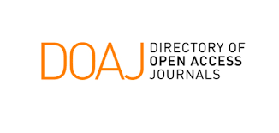
Improving Journal Quality - 4
4. Principles of Transparency and Best Practice
Identifying and dealing with research misconduct
Publication ethics
Publishing schedule
Access
Archiving
Website
Journal’s name
Peer review process
Editorial board
Copyright and licensing
Source: https://publicationethics.org/resources/guidelines-new/principles-transparency-and-best-practice-scholarly-publishing
Copyright © 2018 Enago Academy | All Rights Reserved.
Notes:
Source: https://publicationethics.org/resources/guidelines-new/principles-transparency-and-best-practice-scholarly-publishing
Website: A journal’s website, including its textual content should adhere to high ethical and professional standards. The information should not might mislead readers or authors. Also, there should not be any duplication of another journal/publisher’s site. The ‘Aims & Scope’ statement on the website as well as the journal’s readership should be clearly defined. Finally, the journal should clearly state its authorship criteria (e.g., not considering multiple submissions, redundant publications) to be included and ISSNs should be clearly displayed (separate for print and electronic).
Name: The name should be unique such that it cannot be confused with that of another journal or mislead potential authors and readers.
Peer Review process: The process for peer reviewing the journal’s content should be clearly defined. This process, as well as the policies related to the journal’s peer review procedures, should be described on the website. Also, there should not be any statement guaranteeing manuscript acceptance or a very short peer review time period.
Editorial board: The board or any other governing body should have recognized experts of the subject areas fall under the journal’s scope. The affiliations of the journal’s editorial board or other governing body should be provided on the journal’s website.
Copyright: The copyright policies should be stated in the author guidelines along with the name of the copyright holder. Also, licensing information should be described on the website, and licensing terms for all published articles (both HTML and PDFs) should be defined. If authors can publish under CC licensing then specific license requirements should be provided.
Research misconduct: Publishers and editors should follow necessary steps to identify and prevent the publication of papers in which possibly research misconduct has been noticed. This includes issues such as plagiarism, citation manipulation, and data falsification/fabrication. Also, to deal with the allegations, journal’s editors or the journal’s publisher should follow COPE’s guidelines if any allegation of research misconduct has been reported.
Publication ethics: The journal’s policies on publishing ethics should be clearly visible on its website and share information on: i) authorship and contributorship; ii) handling of complaints and appeals; iii) reporting of conflicts of interest / competing interests; iv) data sharing and reproducibility; v) ethical oversight; vi) intellectual property; and vii) post-publication discussions and corrections.
Publishing schedule: The periodicity at which a journal publishes shall be clearly indicated.
Access: The way(s) in which the journal and individual articles are available to readers and the nature of the fees that need to be incurred are clearly defined.
Archiving: A journal’s plan for electronic backup and preservation of access to the journal content (for example, access to main articles via CLOCKSS or PubMed Central) in the event a journal is no longer published shall be clearly indicated.

Slide 40
Open Access and Predatory Publishing
Copyright © 2018 Enago Academy | All Rights Reserved.

Slide 41
Open Access – What & How
Journals should follow either the gold, hybrid, or delayed open access models
Ensure that the journal gets indexed in DOAJ, Web of Science, Scopus or PubMed.
In most open access models, authors should have the copyright of their publication without restrictions.
Use of Creative Commons licences for sharing copyrighted material of open access journals.
DOAJ is the most well-known database for open access journals. The five basic criteria for indexing by DOAJ are given below:
Basic journal information,
Quality and transparency of the editorial process,
Openness of the journal,
Content licensing, and
Copyright issues.
NOTE: DOAJ does not index those journals that follow the “hybrid” open access model.
Copyright © 2018 Enago Academy | All Rights Reserved.
Notes:
https://www.scienceopen.com/document/vid/2befee62-f9c0-4dc8-93c5-790d6102877d#abstract
Maybe you add OJS

Slide 42
Identifying the Target OA Journal
Select journals from literature review
Journal metrics like Impact Factor
Google Scholar, ResearchGate, Academia.edu, DOAJ
Established publishers
Known journals
Selection tools like Enago Open Access Journal Finder
Ask colleagues/seniors
For open access journals, this selection is important to avoid publishing in predatory/hijacked journals.
Notes:
Enago Open Access Journal Finder enables you to find quality open access journals that are pre-vetted to protect you from predatory publishers. This free journal finder solves common issues on predatory journals, journal authenticity, and article processing fees by utilizing a validated journal index provided by the Directory of Open Access Journals (DOAJ). Enago’s proprietary search algorithm helps you shortlist journals that are most relevant to your manuscript and research objectives, thus giving you the best chance of publication.

Slide 43
Predatory Journals – Hallmark
Large numbers of journals across disciplines in very generic subject areas
The editorial board of the journal does not reflect the expertise required based on the journal’s “Aims and Scope”
No standard peer review process/short turnaround times
Excessive APCs
No/minimal citations; unprofessional formats
Vague and ambiguous contact details
Journal’s website looks unprofessional look with vague English
Copyright © 2018 Enago Academy | All Rights Reserved.
Notes:
https://www.stm-assoc.org/2015_02_20_STM_Report_2015.pdf
https://www.nature.com/news/stop-this-waste-of-people-animals-and-money-1.22554
https://bmcmedicine.biomedcentral.com/articles/10.1186/s12916-015-0469-2

Slide 44
Hijacked Journals – Characteristics
Duplicate websites of authentic ones
Use titles and ISSNs of indexed/reputable journals.
Like predatory journals, they release a large number of journals across disciplines
Accept submissions from misguided authors who think they are authentic journals
They specifically duplicate websites of non-English journals so that authors cannot easily identify the duplication.
Many non-English journals published by smaller publishers have fallen prey to this.
Fake acceptance letters on letterheads of authentic journals
Copyright © 2018 Enago Academy | All Rights Reserved.
Notes:
https://www.stm-assoc.org/2015_02_20_STM_Report_2015.pdf
https://academic.oup.com/asj/article/36/6/739/2664479
https://www.ncbi.nlm.nih.gov/pubmed/28378542
https://scholarlykitchen.sspnet.org/2018/04/18/paper-acceptedunless-letter-forged/

Slide 45
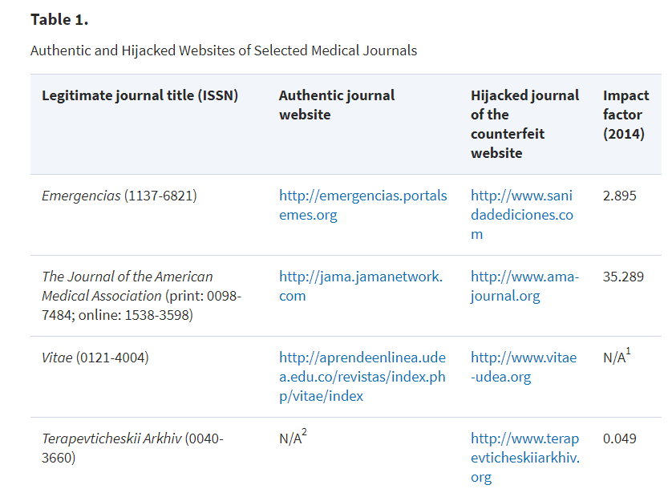
Predatory publishers/journals - 3
Hijacked Journals – Examples
Figure: The table shows the hijacked links of some authentic Russian journals. Source: Dadkhah M et al. Hijacked journals: an emerging challenge for scholarly publishing. Aesthetic Surgery Journal. 2016, 36, 739.
Notes:
https://academic.oup.com/asj/article/36/6/739/2664479

Slide 46
Case Studies of Russian Journals
Copyright © 2018 Enago Academy | All Rights Reserved.

Slide 47
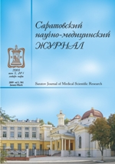
Case studies of Russian journals
Saratov Journal of Medical Scientific Research (SJMSR)
Moscow Mathematical Journal (MMJ)
Copyright © 2018 Enago Academy | All Rights Reserved.
Notes:
Source: http://www.ease.org.uk/wp-content/uploads/kiselevesenov12.pdf and https://herb.hse.ru/data/2017/03/05/1166793604/1HERB_11_view.pdf

Slide 48
Case Study – SJMSR - 1
In 2002, Saratov Journal of Medical Scientific Research (SJMSR) was launched.
In 2009, a new set of editorial aims was adopted:
develop an open access electronic version;
print limited copies for Russian academic libraries, the Saratov State Medical University and individual subscribers;
prioritize publications of distinguished foreign authors, eminent Russian scientists and young specialists;
free publication of manuscripts with high reviewer scores
for ~30% of articles, publication fees were charged (funds via authors’ institutions or research funds)
Copyright © 2018 Enago Academy | All Rights Reserved.
Notes:
Source: http://www.ease.org.uk/wp-content/uploads/kiselevesenov12.pdf
Initially, SJMSR was produced only in print with a circulation of only 500 copies and was largely unknown to the medical community. To improve the journal’s visibility and performance, a new set of editorial aims was adopted.

Slide 49
Case Study – SJMSR - 2
In 2009, the journal’s format was modernised, a website (www.ssmj.ru) was launched, and the editorial workflow was improved.
All articles published on the website were open access.
The quality of English page was specifically improved, which helped SJMSR get indexed by
Ulrich’s International Periodicals Directory,
Index Copernicus,
Directory of Open Access Journals,
Open J-Gate,
Google Scholar,
Chemical Abstracts Service,
EBSCO,
and more than 50 international scientific and medical websites provided links to the journal’s website.
Electronic document management was implemented and presence on Twitter, Facebook, ResearchGate and SciPeople was increased.
Copyright © 2018 Enago Academy | All Rights Reserved.
Notes:
Source: http://www.ease.org.uk/wp-content/uploads/kiselevesenov12.pdf
As part of the new policy, the website was completely revamped, and all articles were published in the open access format. With these changes, the indexing of the journal considerably improved too and the editors also began promoting the article on social media forums.

Slide 50
Case Study – SJMSR - 3
In 2010, SJMSR began online processing of submissions in both Russian and English languages.
Citation rate in RSCI increased from only 4 in December 2008 to 143 in March 2012.
Submissions increased (from 131 in 2008 to 349 in 2011) with a higher acceptance rate (~35% by November 2012).
To increase funding and to improve the quality of the peer review and accepted articles, a fully English version of SJMSR has also been launched.
Copyright © 2018 Enago Academy | All Rights Reserved.
Notes:
Source: http://www.ease.org.uk/wp-content/uploads/kiselevesenov12.pdf
The policy changes significantly improved the citation rate in RSCI from 4 to 143 by March 2012. This corresponded to an increase in submissions too and a higher acceptance rate.
The English content also helped the journal get indexed by search engines, which became the primary sources for getting visitors/potential authors.
Given the positive improvement, a completely English version of SJMSR was also launched, which helped gain better funding.

Slide 51
Case Study – MMJ - 1
Among the leading mathematical journals in Russia, Moscow Mathematical Journal (MMJ) is the latest one.
MMJ’s success is mostly because of IUM’s reputation and the Moscow mathematical school.
MMJ’s editors have maintained high standards for accepting papers.
For increased submissions, organized thematic and/or anniversary issues of MMJ were prepared by guest editors (specifically Russian or former Russian mathematicians).
Copyright © 2018 Enago Academy | All Rights Reserved.
Notes:
Source: https://herb.hse.ru/data/2017/03/05/1166793604/1HERB_11_view.pdf
MMJ has consistently been among the top six Russian mathematical journals. Its success can be attributed to the Independent University of Moscow, which is well known internationally. Also, MMJ’s association with the Moscow mathematical school has been a contributor to its sucess.

Slide 52
Case Study – MMJ - 2
MMJ publishes papers in English unlike other Russian journals (translate Russian papers to English).
MMJ has published 4 issues every year and ~30-35 articles are published every year.
In 2015 and 2016, the journal published 71 papers authored by 120 researchers:
27 of these authors were Russian mathematicians (work permanently in Russia)
93 were international mathematicians, including 24 of Russian/Soviet origin.
Copyright © 2018 Enago Academy | All Rights Reserved.
Notes:
Source: https://herb.hse.ru/data/2017/03/05/1166793604/1HERB_11_view.pdf
MMJ does not aim to achieve any target ratio between Russian and foreign authors.

Slide 53
Case Study – MMJ - 3
MMJ is distributed by the American Mathematical Society.
Since 2009, MMJ has been indexed by WoS, followed by indexing in Scopus.
Based on 2017 data, MMJ has an impact factor of 1.041.
MMJ’s example provides directions for a new journal’s success:
well-established subject area,
good university or research institute as a publisher,
better composition of editorial board,
extremely strict review of submissions,
primary language of English, and
efforts of journal editors to attract new authors.
Copyright © 2018 Enago Academy | All Rights Reserved.
Notes:
Source: https://herb.hse.ru/data/2017/03/05/1166793604/1HERB_11_view.pdf
https://www.scijournal.org/impact-factor-of-MOSC-MATH-J.shtml
Because of the impressive editorial board, many western universities have subscribed to it.

Slide 54
Quick Takeaway Points
*Source: SciVal by Elsevier
Copyright © 2018 Enago Academy | All Rights Reserved.

Slide 55
Takeaway Points (Author)
Proper journal selection
Read the author guidelines!
International collaboration
Be aware of best practices in publication ethics
Ensure high English language quality – very critical for international journals
Copyright © 2018 Enago Academy | All Rights Reserved.
Notes:
Be aware of best practices in publication ethics → Plagiarism, image manipulation, salami slicing, duplicate submission, authorship

Slide 56
Takeaway Points (Journal Editor)
Make sure your peer review system is up to date
Support initiatives designed to reduce academic misconduct
Support initiatives to educate researchers about publication ethics
Publish clear instructions in your journals about submission and what you expect from authors
Have systems in place to detect falsified data, e.g. manipulated photographic images or plagiarized text (either for routine use or when suspicions are raised)
Copyright © 2018 Enago Academy | All Rights Reserved.
Notes:
Image Manipulation: Forensic Droplets (https://ori.hhs.gov/droplets), Adobe Bridge, ImageJ (freely available from https://imagej.nih.gov/ij/), and Image Data Integrity (http://www.imagedataintegrity.com/about.html)
https://ori.hhs.gov/actions
https://www.elsevier.com/editors-update/story/publishing-ethics/the-art-of-detecting-data-and-image-manipulation

Slide 57
Takeaway Points (Publisher)
Follow ethical practices
Proper and complete journal website (possibly with an English version)
Make your content findable (= electronic)
Use DOI system
Make it readable (= English abstracts, references, full paper)
Work with international organizations -- ORCID, Crossref, DOAJ
Promote published papers
Use hosting services aggregators
Copyright © 2018 Enago Academy | All Rights Reserved.

Slide 58
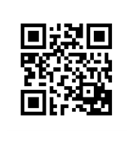
Download the Enago Academy app to get free updates on the latest developments in publishing!
Questions and Answers
(Or visit: enago.com/app)
Copyright © 2018 Enago Academy | All Rights Reserved.

