Slide 1
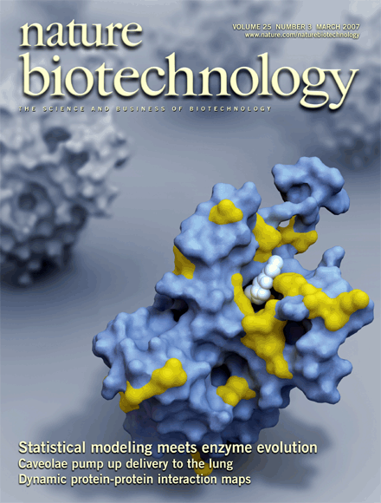
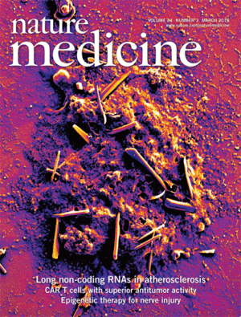
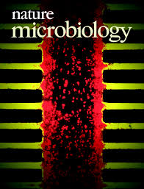
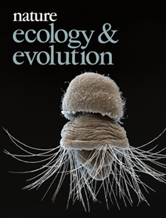
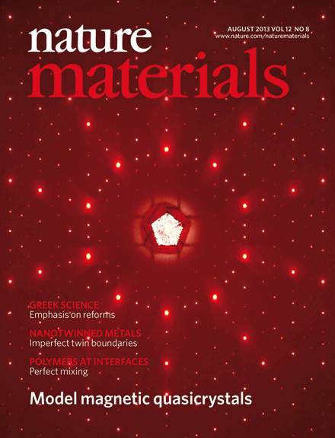
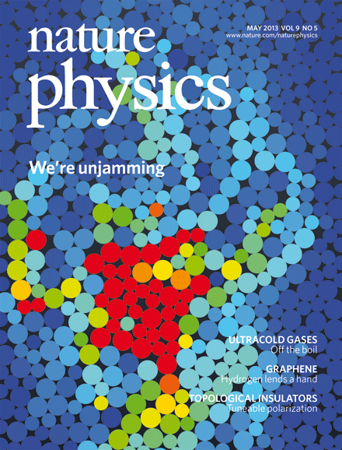
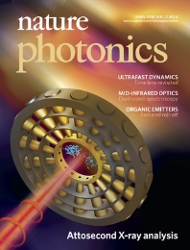
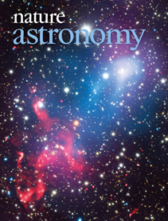
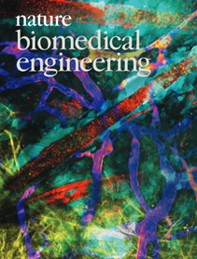
«Организация процесса прохождения рукописей в Springer Nature»
Daria Iovcheva

Slide 2
Springer Nature – Brands

Slide 3
Nature’s hits …
Nature’s hits …… and misses
- Discovery of X-rays (Röntgen, 1896)
- Wave nature of particles (Davisson & Germer, 1927)
- Discovery of the neutron (Chadwick, 1932)
Structure of DNA (Watson & Crick, 1953)
Discovery of pulsars (Hewish, Bell, Pilkington, Scott & Collins, 1968)
- Cloning of ‘Dolly’ the sheep (Wilmut et al., 1997)
- …
- Krebs cycle (rejected without review)
- Pavlov’s obituary (published while still alive)
- Schön case (fraud)
- …

Slide 4
Why publish in a Nature Research Journal?
Exposure
Your paper will be seen beyond your (specialist) field
Prominence
Your paper will be one of a few — not lost in a sea of others in one issue Nature Physics publishes about 150 papers year^{–1}
Possibility of News & Views, cover, press release, ...
Care
If we send your paper to referees we want to publish it
The editor handling your paper provides ‘personal assistance’ A Nature Physics editor publishes about 25 papers year^{–1}
Notes:
I like this statement (it’s from Andreas’ presentation), but shouldn’t it be the other way around: “The editor handling your paper will consider it his/her champion”? Are the numbers 30 and 300 still correct?

Slide 5
What do the editors do?
Select the top papers submitted to the journal
Read the cover letter, manuscript and supplementary information
Do a literature search and consult additional sources
Discuss the paper with other editors; sometimes seek informal advice from an expert
Reach a decision whether to send the paper out for formal review or not
Handle the selected papers (referees, reports, decisions)

Slide 6
What are the editors looking for?
There is no definitive answer to this question; there is no secret formula...
The goal is that every paper published [in Nature [X]] provokes a response [from any [X-ist]] of the type “Wow! I didn‘t expect that!” or “Wow! That‘s clever/useful!”
There are some criteria (‘necessary ingredients’)
Significant advance in our understanding
Broad relevance beyond the immediate field of research
Comprehensible story
Referees judge technical correctness, novelty, broader relevance and accessibility

Slide 7
Preparing a submission — what to keep in mind?
Publishing starts with new results… Think well ahead and self-reflect (“Where does my work fit into the field?”)
High-impact journals don’t consider work representing an incremental step forward (no matter how hot the topic!)
Avoid salami-slicing — an all-in paper has more chance of being published quickly than one based on partial results!
Don’t confuse scientific interest with ‘newsworthiness’
Read a journal’s guide to authors and comply with its policies
Don’t be shy to approach high-impact journals with your best work!
Results should speak for themselves — but you have to help the reader to get the message

Slide 8
Preparing a submission — practicalities
At the initial submission stage format is not really important. Spend your time on the clarity and accessibility of your paper
Prepare a cover letter — a good cover letter is very useful for editors!
Explain (informally) the appeal of your work (but don’t oversell it)
Referee suggestions are welcome (but don’t suggest your former supervisor or students or (recent) collaborators — editors check!)
Referee exclusion requests are usually honoured, as long as they are reasonable
Identify all related papers in press or submitted elsewhere

Slide 9
The editorial process at a Nature Research Journal
First decision (reject or send out for peer review) within one week (as far as possible)
An editor reads the manuscript; often discusses manuscripts with other editors; sometimes informally consults an expert
Typical editorial checks:
What is the novelty of the claims?
How well do the data support the claims?
Is the work of interest beyond the specialist community?
Decision is to a great extent based on editor expertise A Nature Physics editor reads about 400 papers year^{–1}
When in doubt, send it out!

Slide 10
The editorial process at a Nature Research Journal
Reject
Accept
Submission
Reject minor revision
Editorial decision
Peer review
Editorial decision
Reject major revision
Reject

Slide 11
Decisions after review
Editors make a decision (Accept, Reject – minor revision, Reject – major revision, Reject) based on the referee reports
We ask referees to comment on the merits of a paper and its technical correctness — not whether they think the paper should be published in our journal or not
We don’t count votes!
Revisions must make substantial progress towards justifying publication
In borderline cases we try to avoid multiple rounds of review — almost good enough is not good enough…
We can be patient and wait for extra work to be completed
Editors take ultimate responsibility for decisions

Slide 12
Resubmitting
If invited to resubmit, only do so after you have addressed all of the referees’ comments
If extra work was requested, don’t try to argue your way out of it!
Be professional and respectful — our referees are your peers and colleagues
If a referee has misunderstood or failed to appreciate the significance of your work, that may be not his/her fault alone

Slide 13
Manuscript transfer
If rejected by Nature Physics, you can transfer your manuscript to another Nature Research Journal, Nature Communications or any other Springer Nature journal via a link provided
You can choose to opt out of inter-journal editorial consultations
Nature Research Journals and Nature Communications are editorially independent

Slide 14
Paper accepted!
It takes 4 – 6 weeks from acceptance to (online) publication
Please respect our embargo — no news stories before (online) publication
Please do discuss your work with colleagues (e.g. at conferences) and post it on preprint servers (e.g. arXiv)
‘Nature benefits’:
Professional copy- and art-editing
Possibility of a News & Views
Possibility of a press release
Wide dissemination
Copyright rests with authors
Notes:
Number more or less correct?

Slide 15
Thank you
Daria Iovcheva
Daria.iovcheva@springernature.com
+7 925 016 01 56

