Slide 1
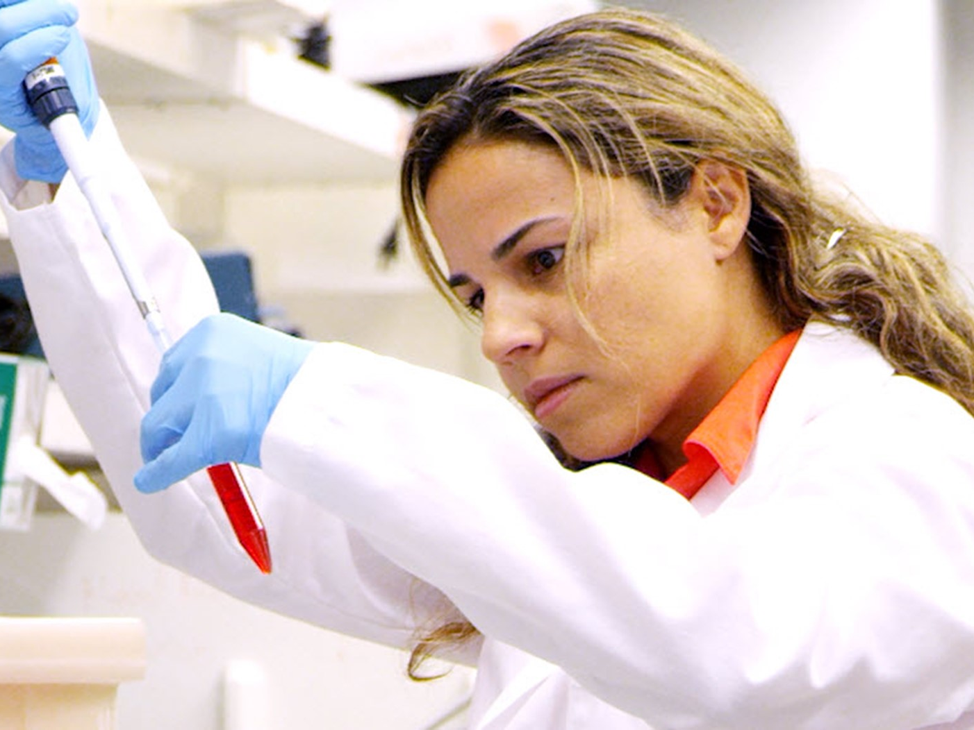



Scopus & Open Access
Moscow
ASEP April, 2018
Notes:
[Notes: This slide deck was created in response to several requests for an external version of the 2017 Strategy Cascade deck.
You’re encouraged to present these slides in your own words and incorporate the slides into your own decks.
Please remove the script, convert to PDF format and use discretion when sharing these slides externally. For a “leave-behind piece” use the Elsevier Corporate Brochure or send the link https://www.elsevier.com/about/this-is-Elsevier
Below is a sample script to provide ideas on how these slides might be verbalized in the context of an introduction at the top of a customer meeting. Your feedback is always welcomed. Thanks, C.lowe@Elsevier.com, VP Strategic Communications and Brand.]
Script:
Thanks for having us here today. We’re going to cover X, Y, and Z [fill in your agenda]; but I’d like to begin with a brief overview.
I’m often asked about what’s happening at Elsevier and how Elsevier is reacting to shifts in the industry.
The answer is that it’s an exciting time; an opportunity to address several challenges in science and health.

Slide 2

Our customers are facing challenges in science and health
Global research spend is growing every year.¹
Researchers lack the tools they need to be effective.²
Studies:
70-80% of
research asks the
wrong questions
or cannot be
reproduced
Predicted spend
$1.9TN
research in 2016
3.4%
from 2015
Life-saving drugs are expensive to develop.³
Health providers cannot save lives without the best information.⁴
1/20
success rate
of drugs
$2.5BN
median pharmaceutical
spend per drug
Preventable medical errors:
Third largest cause of death in the US
611k
585k
225k
149k
Heart
Disease
Cancer
Medical
Error
Respiratory
Illness
Elsevier is in a unique position to make a contribution
towards solving these challenges
1. Industrial Research Institute 2. The Lancet 3. Tufts 4. World Health Organization
Notes:
Script: (Slide is set up with animations to break up dense content)
(Click 1) While global research spend is growing every year, we’re hearing from researchers that they still lack effective tools.
(Click 2) A number of recent studies report figures in the area of 70 to 80 percent where research asks the wrong questions, or when the research is completed, it can’t be reproduced*
(Click 3) On the health side, the median cost of developing a drug is now 2.5 billion. Yet the success rate is only 1 in 20.
(Click 4) And alongside heart disease and cancer, the third largest cause of death is medical error.
(Click 5)These are spaces in which information, analytics, and technology can make a significant contribution. And that puts Elsevier in a unique position to aid that effort.
Supplementary notes:
Researchers lack the tools they need to be effective.
*http://www.sciencedirect.com/science/article/pii/S0140673609603299
http://www.nature.com/news/1-500-scientists-lift-the-lid-on-reproducibility-1.19970
http://www.cchsr.iph.cam.ac.uk/1714
Doctors cannot save lives without the best information.
The original study for the 225,000 number first appeared in the of the Journal of the American Medical Association: http://www.health-care-reform.net/causedeath.htm
Also: more recent study in the BMJ which puts it at 170 000 – 251 0000: http://www.bmj.com/content/353/bmj.i2139/rapid-responses

Slide 3

To help customers meet those challenges:
Elsevier combines content with technology to provide actionable knowledge
Operational Excellence
Quality Content
Technology
Chemistry database
500m published experimental facts
1,000
technologists employed by Elsevier
User queries
13m monthly users on ScienceDirect
Machine reading
475m facts extracted from ScienceDirect
Books
35,000 published books
Semantic Enhancement
Knowledge on 50m chemicals captured as
11 billion facts
Drug Database
100% of drug information from pharmaceutical companies updated daily
Machine learning
Over 1,000 predictive models trained on 1.5 billion electronic health care events
Research
16% of the world’s research data and articles published by Elsevier
Collaborative filtering:
1bn scientific articles added by 2.5m researchers analyzed daily to generate over 250m article recommendations
Notes:
Script:
We’ve been working on combining our vast quantities of structured data with technology, supported by our operational expertise.
You may know us for content from articles and books, but for example, we hold 500m experimental facts in our chemistry databases.
We collect 13M user queries on ScienceDirect every month. Elsevier is sitting a top a trove of “big-data”.
And we’ve built the technology muscle to process that data. We employ over 1000 technologists.
We’re using artificial intelligence such as machine reading and machine learning. As an example of scale on ScienceDirect, we employ collaborative filtering, analyzing 1bn articles from 2.5m researchers daily, to generate 250m article recommendations.

Slide 4

We help answer questions
that matter to researchers
and health practitioners
For
clinicians
‘You could use this treatment to save a life’
For
researchers
‘This article answers your questions’
For
governments
‘This is the research to invest in’
For
pharmaceutical
companies
‘This is the cancer treatment you should pursue’
For
nursing
students
‘This is the area you need to improve to qualify’
Notes:
Script:
And this puts us in a position to help customers answer a set of critical questions:
We can make treatment recommendations to clinicians at the point of care.
We can help direct researchers to answers faster.
We can advise governments on how to look at their research investments, and what to consider strategically
We can advise pharma companies on what treatments they might pursue, what drug candidates might they fast-track for example.
And we can tell nursing students the precise areas they need to improve in order for them to qualify for their certifications.

Slide 5
Elsevier – Who we are
Elsevier is a global information analytics business that helps institutions and professionals advance healthcare, open science, and improve performance for the benefit of humanity.
We serve the research, academic and clinical communities through the application of technology and analytics to content. In this way, we empower those communities to contribute to social progress, to enhance human well-being and to share and expand the breadth of human knowledge.

Slide 6
Elsevier and open access
Gold open access
Leading gold open access publisher
Publish over 170 fully open access journals
Publish over 1,850 hybrid journals
Published over 25,000 open access articles in 2016
Choice of either a commercial (CC BY) or non-commercial (CC-BY-NC-ND) user license.
Article publishing charges (APCs) range from c$150- c$5000 (US Dollars)
Green open access
Largest publisher enabler of green open access
All 2500+ journals provide a green open access option
Participate in CHORUS and support pilots with institutions and international funders
Free API program to fuel repositories
Share link service provides 50 days free access to recently published research
Open archives in 108 journals, including Cell Press titles after 12 months

Slide 7

















Empowering open access
Collaboration with funders and institutions generated 7,000 extra open access articles in 2016.
Work together by:
  Optimizing the publication process to make authors aware of how to comply with funder mandates
  Provide an API program to fuel institutional repositories
  Support funders and institutions participating in CHORUS
  Provide customized reporting, monitoring and tailored invoicing for institutions
  Train customer service staff to help researchers understand funder and institutional OA policies and how to comply
Notes:
Elsevier is proactively working with funding bodies to develop agreements which make it easy for authors to publish in Elsevier journals.
These agreements help to implement open access policies in a sustainable way for both the academic community, our journals and the wider public.

Slide 8
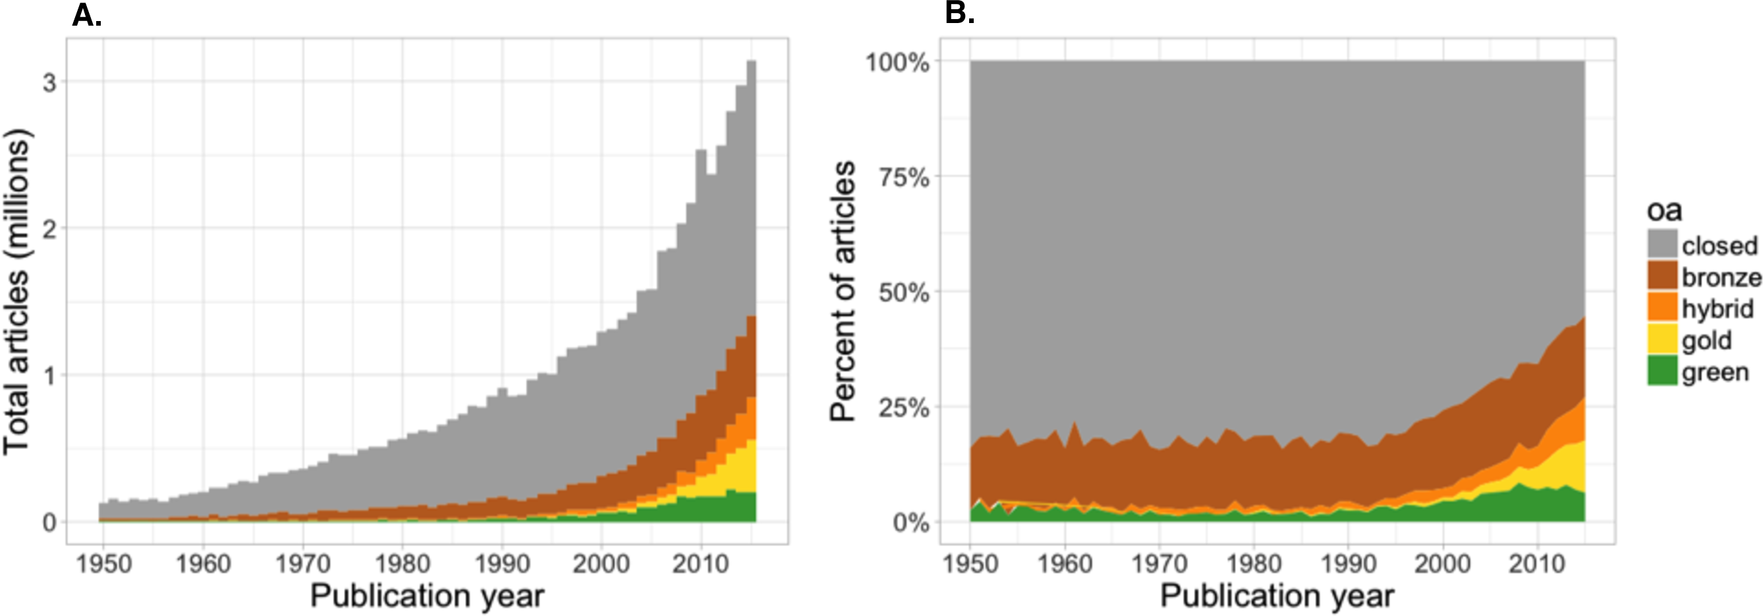
Open Access (OA) is on the rise over 15 years
Approximately 28% of all scholarly research is published as OA.
In recent years as much as 45% of content published is OA.
The state of OA: a large-scale analysis of the prevalence and impact of Open Access articles
Source: https://peerj.com/articles/4375/#fig-5
Notes:
Article title: The state of OA: a large-scale analysis of the prevalence and impact of Open Access articles
Source of data in this article is oaDOI
OA movement is 15 years old.

Slide 9
Driven by global funding body policies
OSTP
US Federal Agencies formulating policies following OSTP memo:
Research results available within 12 months of publications
Make unclassified data available to the public
Canada
Gold - permitted, no additional funding provided
Green -12 months embargo
HEFCE
Gold – permitted, no specific license, no new funding
Green - Deposit AM in repository
(12/24 month embargo)
RCUK
Gold – preferred, with funding available, CC BY
Green - 12/24 month embargo
Wellcome Trust
Gold – preferred, with funding available, CC BY
Green – 6 month embargo and deposit in PMC
Department of Energy (DOE)
Deposit within 12 months of publications
Howard Hughes Medical Institute (HHMI)
Deposit in PMC within 12 months of publication
FWF (Austria)
Gold – CCBY, funding available
Green: 6 /12 month embargo
National Natural Science Foundation of China (NSFC)
Green - self-archive in institutional repository within 12 months
National Institutes of Health (NIH)
Deposit in PMC within 12 months of publication
Chinese Academy of Sciences (CAS)
Gold - permitted, no funds for APCs
Green – Self-archive within 12 months
National Science Foundation (NSF)
Deposit within 12 months of publication
European Commission (Horizon 2020 program).
Gold – permitted, post grant pilot with OpenAire
Green – 6 months embargo (or 12 months embargo for humanities and social sciences)
Australian Research Council (ARC)
Green – outputs must be made openly accessible within 12 months
Bill & Melinda Gates Foundation
Deposit within 12 months of publication; from 2017 onwards immediate gold
APC funding available

Slide 10
Total article growth by journal business model (who pays)
In 2016 there were an estimated 2.1 million subscription and 0.5 million open access articles published worldwide.
  Subscription content
  80% share of total articles in 2016
Open access content
APC-based open access articles is 16% share of total content in 2016
All gold open access, including subsidized articles, is 20% share of total content.
Elsevier perspective
In 2016, Elsevier published around 420,000 articles
  Includes over 25,000 open access articles
Source: Elsevier internal Open Access market tracking

Slide 11
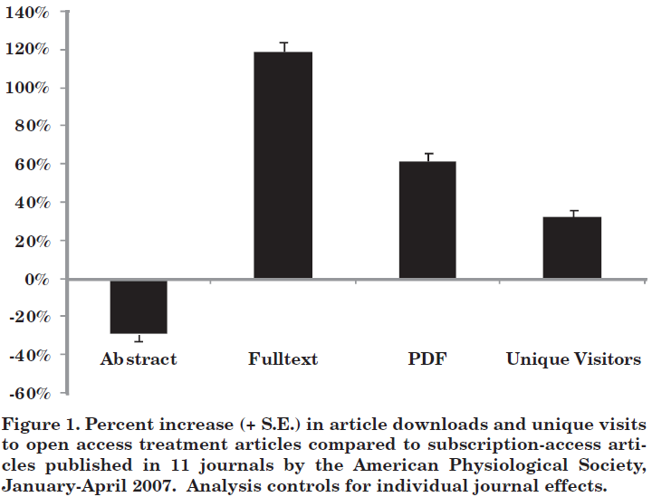
OA can increase the visibility of research
Randomised controlled trial of gold OA vs. subscription-access articles showed increased HTML and PDF downloads and unique visitors in the first 12 months after publication for OA articles
Source: Davis, P.M. (2010) Does Open Access Lead to Increased Readership and Citations? A Randomized Controlled Trial of Articles Published in APS Journals, Physiologist 53 (6) pp. 197-201

Slide 12
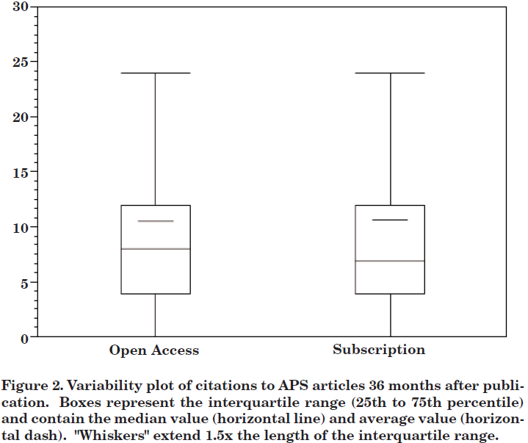

But it doesn’t (yet) impact citations
Results: Open access treatment articles received significantly more article downloads and reached a broader audience, yet were cited no more frequently, nor earlier, than subscription-access control articles.
No clear citation advantage for gold open access articles
Studies do show what impacts citations:
  Research quality
  Article type
  Team size
Studies need to:
  Be careful with selection bias
  Control for factors that impact citations
  Be clear on the definition of OA
Join the conversation:
https://www.mendeley.com/groups/5197801/citations-open-access-compared-with-subscription-articles/
Source: Davis, P.M. (2010) Does Open Access Lead to Increased Readership and Citations? A Randomized Controlled Trial of Articles Published in APS Journals, Physiologist 53 (6) pp. 197-201
Notes:
Given our interest in open access publishing and to ensure we are offering the best support and guidance to our authors, this is an area of research that is of great interest to us. What we have learned from our review to date is that studies looking into this important area should be careful when it comes to selection bias and control for factors such as research quality, article type and team size, as these are essential to giving us a clear and accurate understanding of citation advantage claims. It is essential that open access is defined clearly and accurately, and that other controls are included, such as controlling for citation advantages that may be associated with particular funders or within particular disciplines. Evidence shows that NIH-funded papers, for example, appear far more often than expected in top-cited article populations. The same may be true for other funders and may skew results by showing an OA advantage when really this is a proxy for a particular funder or the quality of the research it typically funds.

Slide 13
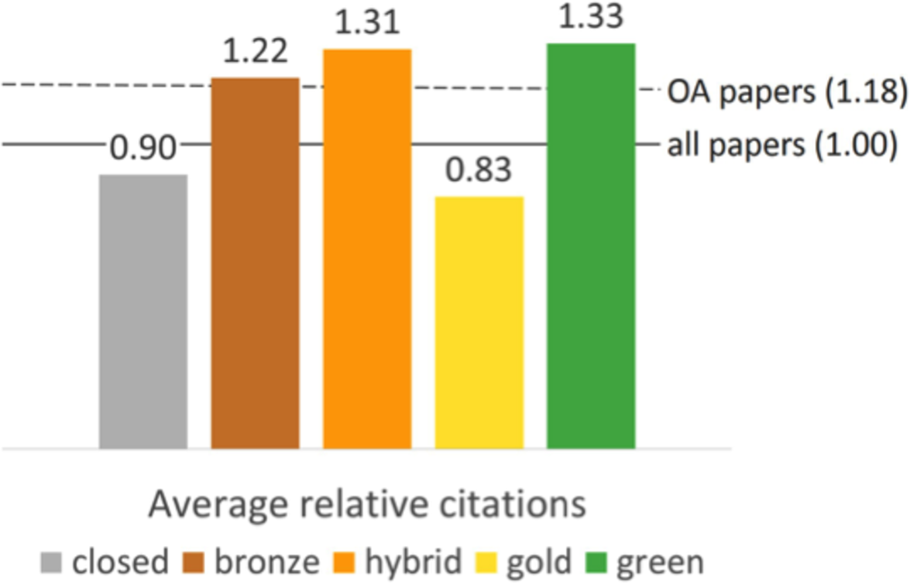
Other studies using different methods have shown a citation benefit on open access papers. Consider yet be aware of the method of these studies
The state of OA: a large-scale analysis of the prevalence and impact of Open Access articles
Source:https://peerj.com/articles/4375/#fig-5

Slide 14
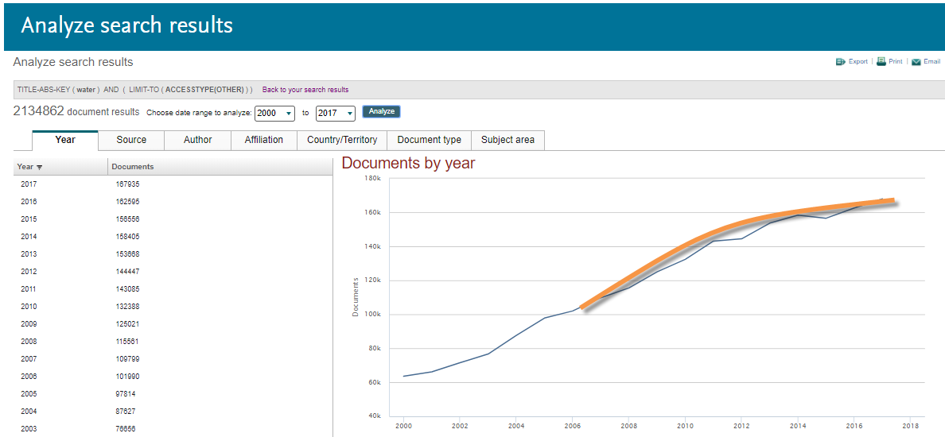
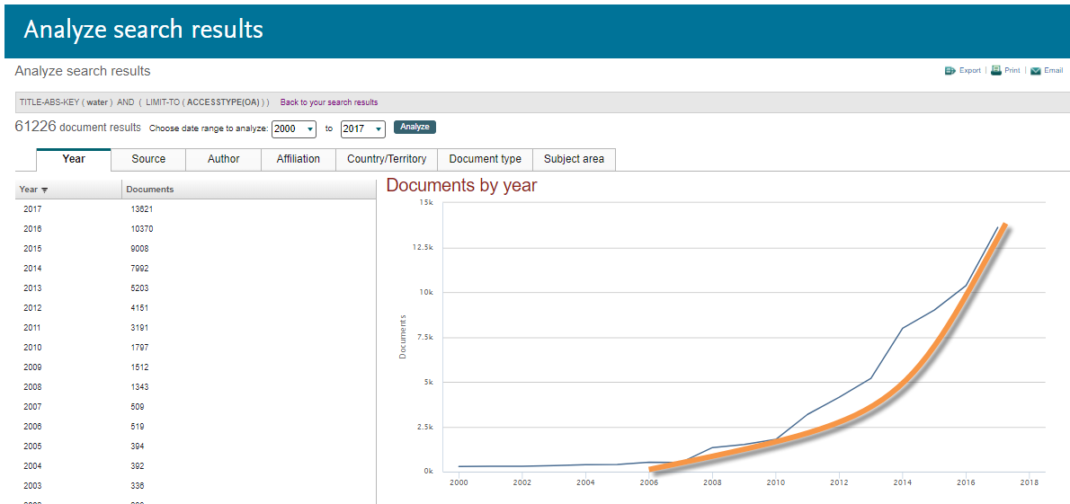
You can also see the growth in OA publishing in Scopus
Non-OA articles
OA articles
Source: Scopus.com
Notes:
Used same subject area & yr window
SA = Water
Yr = 2000 - 2017

Slide 15
OA development in Scopus
In 2015 OA on Journal level was launched in Scopus as Phase I of a larger OA development plan.
  Journals must be registered as being Gold OA in either DOAJ and/or ROAD in order to be marked as OA in Scopus.com.
Phase II was launched in Q1 2018: OA on Article level
  Source of the data is CrossRef
  Current OA article count: 1.45M articles
Phase III expected in Q2/Q3 2018: OA on Article level
  Additional data sources will be added
  Expected OA article count: approx. ~13M OA articles

Slide 16
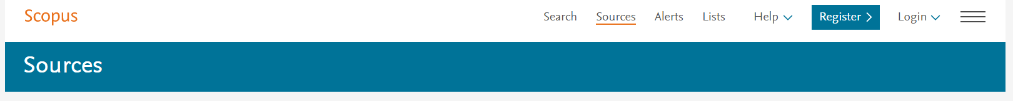
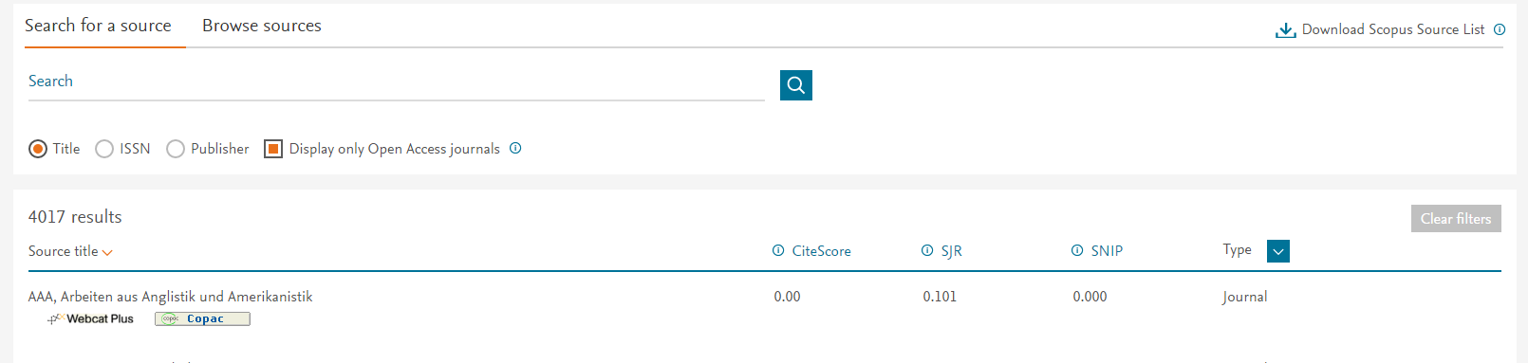
Analyze OA Journals
Gold open access
Indexes >4,000 OA journals also registered at DOAJ / ROAD
List is updated 3-4 times per year
Provide journal level Browse sources indictor
Future hope to include article level
Green open access
For non Gold OA journals; paper can still be OA
Either via:
  The publisher platform or
  Other repositories
In Scopus the link to full-text is always to the original paper via DOI

Slide 17
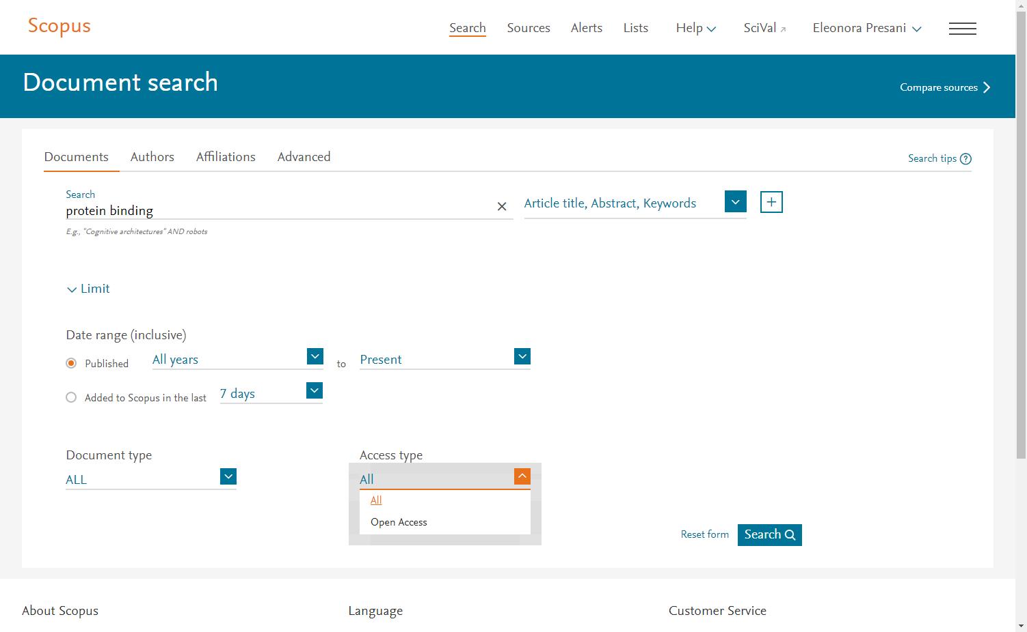
OA article discovery (search) on Scopus.com
In the additional filters available in the homepage, one can select to search only for Open Access articles.

Slide 18
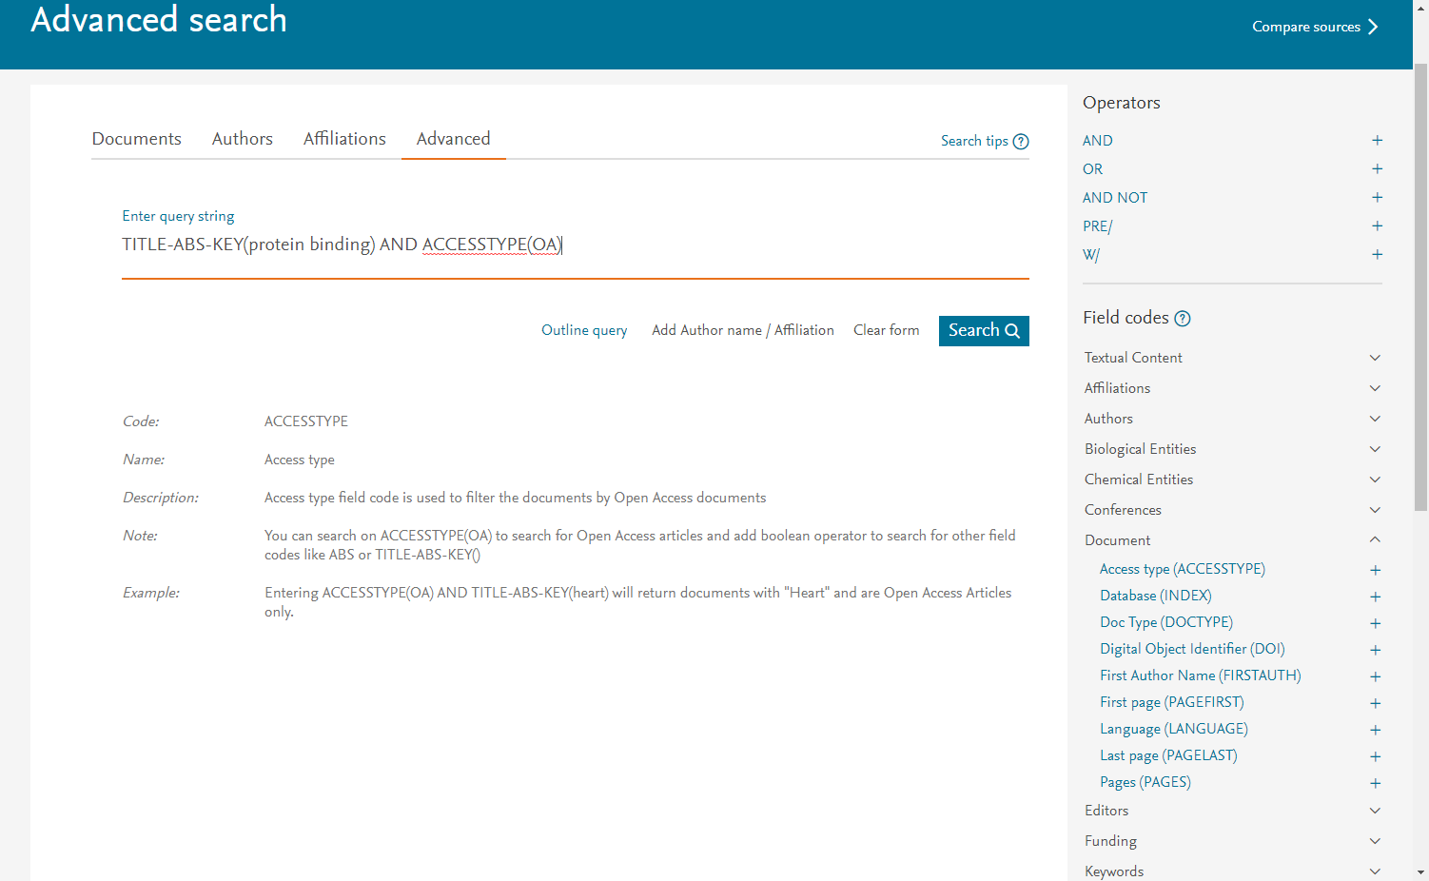
Advanced Search for OA

Slide 19
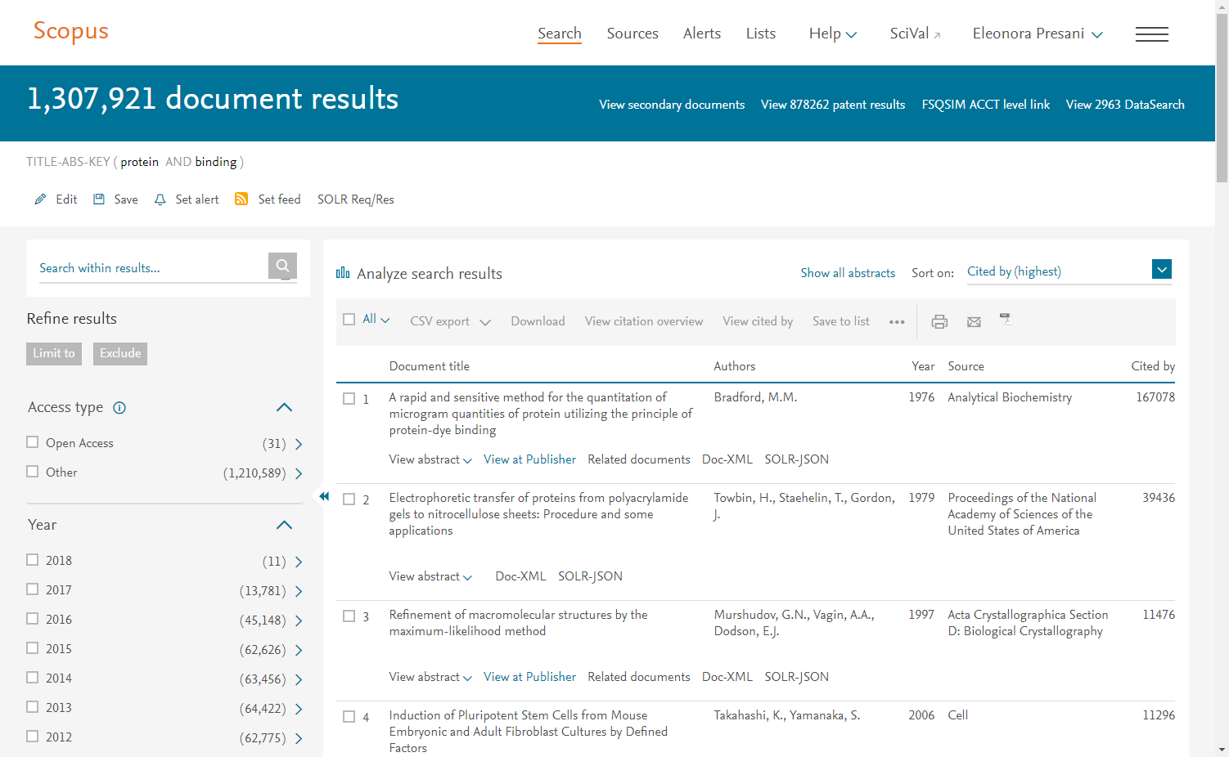
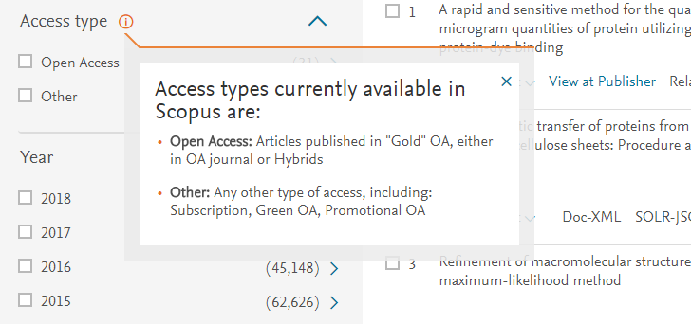
Access Type & Analyze Search Results
In the search result page, one can refine results selecting only OA articles & analyzing results by clicking ‘Analyze Search Results’
Additional explanation shows our interpretation of Open Access and the fact we know we’re not including all OA types.

Slide 20
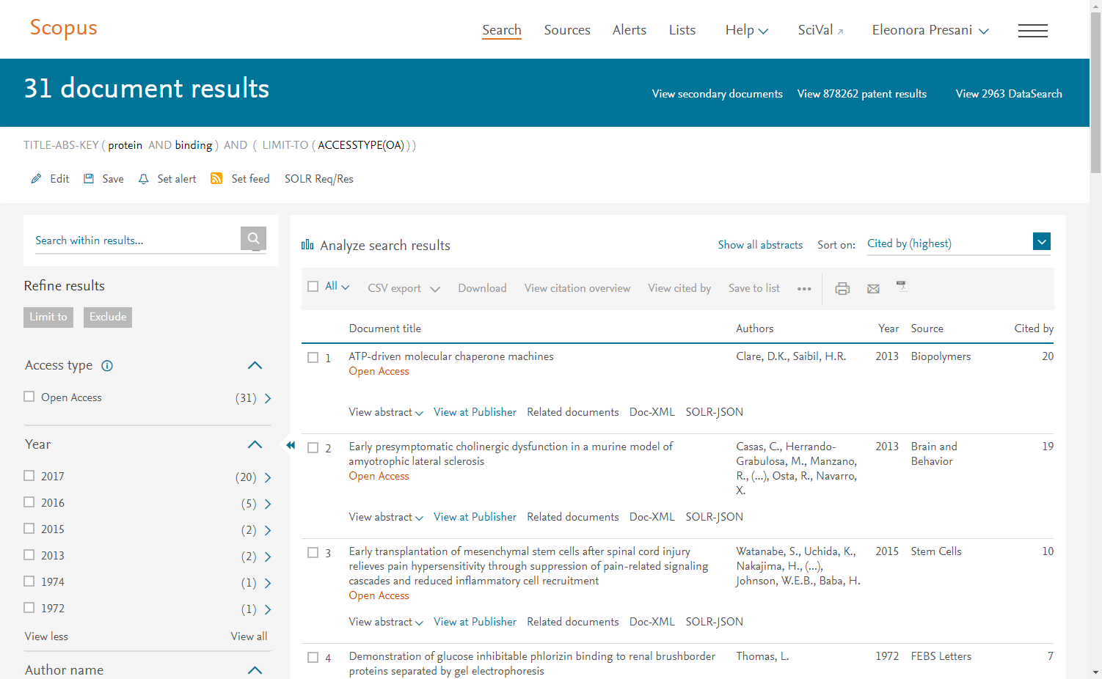
Article Level Indicator

Slide 21
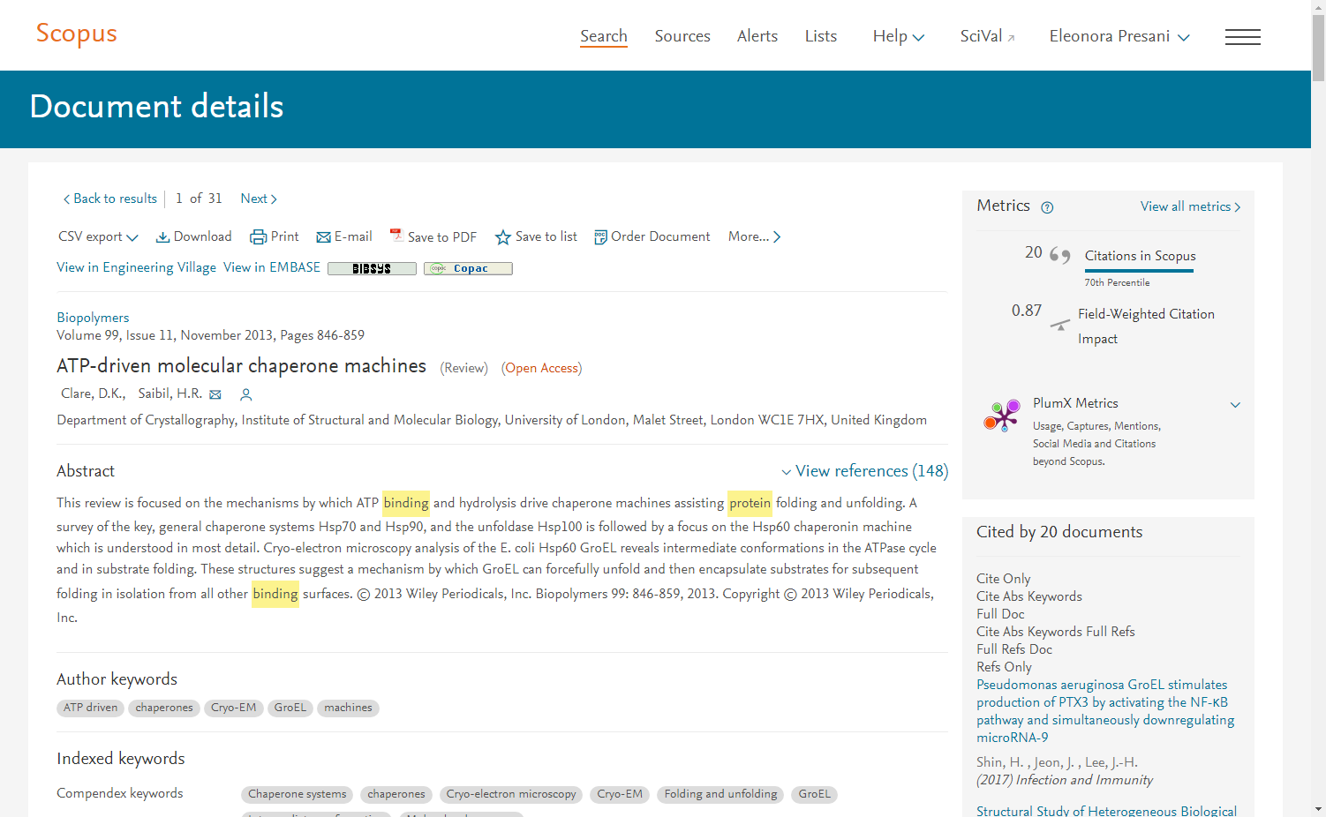
Article Details

Slide 22
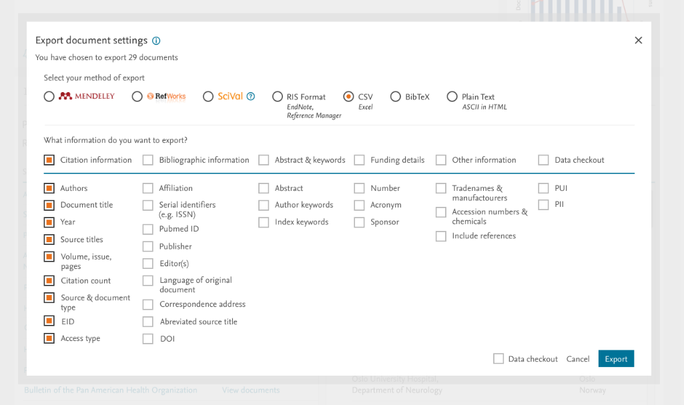
Export functionality

Slide 23

Fueling Institutional repositories: Free API program
Get metadata & abstracts
Show the final version
Keep users on your IR
Make manuscripts public
Article Retrieval API embeds the final article in your repository so subscribers don’t leave your site to access the article
Search API can extract the metadata and abstracts of your affiliated authors to help populate your repository, enhance disoverability and create links or embed final version
Entitlements API** can ensure subscribed users see the final version and visitors can see the accepted manuscript hosted on your repository
Hosting permissions API can retrieve embargo end dates so you can make manuscripts automatically available to the public after embargo
Did you know?
Scopus customers can also integrate Scopus APIs to retrieve metadata and abstracts across all publishers
Please Note: **Minimum part of the program.
//dev.elsevier.com/tecdoc_sd_ir_integration.html
Notes:
Elsevier has developed APIs that IR managers can leverage to showcase their institutional output, increase public access and enhance the user experience in three ways:
1) Increase comprehensiveness of coverage of Elsevier-published content by authors from the institution;
2) Help users to access the best available version; and
3) Keep users in the IR, even when reading final articles.
University of Florida is implementing a system to use the Elsevier APIs to search for and download metadata and abstracts and full text for indexing for articles by UF authors to include in the IR@UF. The pilot partners are testing the integration and application of the APIs and working to design the user experience and interfaces. We have similar pilots with other institutions around the world.

Slide 24
Research Metrics for Open Publishing / Publishers

Slide 25
My publication doesn’t have a J. Imp Factor, what can I show authors?
Which metrics can I offer researchers to evaluate the plethora of OA journal options?
https://journalmetrics.scopus.com/
CiteScore is a simple metric for all Scopus serial titles – freely available incl. data
Example shows CiteScore calculated for 2017
A
A
CiteScore 2017 value
=
B
B
2013
2014
2015
2016
2017
2018
CiteScore
A = citations to 3 years of documents
B = all documents indexed in Scopus, same as A

Slide 26
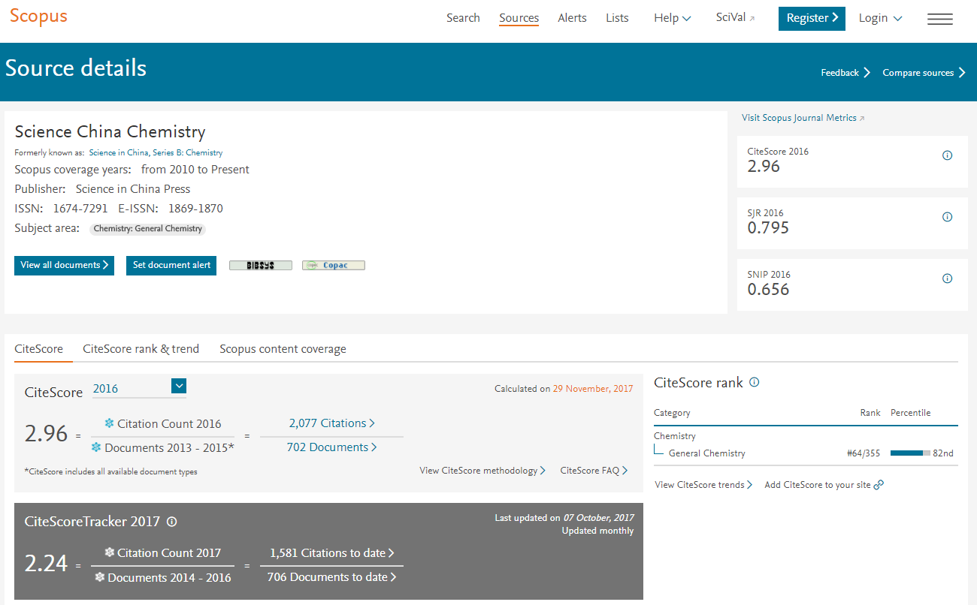
CiteScore is one of a family of related metrics
https://www.scopus.com/sources
https://journalmetrics.scopus.com

Slide 27
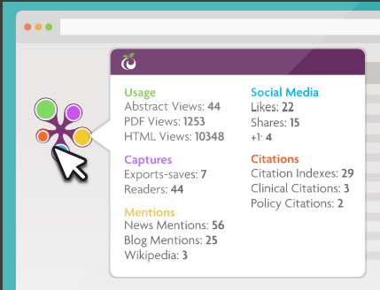
I’m an OA Publisher with interest to demonstrate article level impact of my journal to OA authors (at no cost)
As an journal publisher, I am interested in securing repeat business from the same authors.
Which metrics could I use to demonstrate that publishing in my journal delivered “Impact”?
As you know, citations have limitations in some types of work (Practical) and in some disciplines, and they take time to accrue.
No charge API integration of Plum Widget
https://plumanalytics.com/

Slide 28







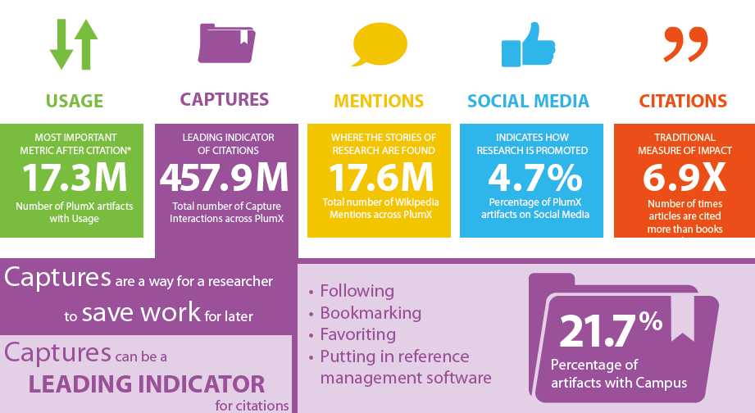
Article Impact metrics - Plum Analytics
USAGE
(clicks, downloads, views, library holdings, video plays)
CAPTURES
(bookmarks, code forks, favorites, readers, watchers)
MENTIONS
(news, science blog posts, comments, reviews, Wikipedia links)
SOCIAL MEDIA
(+1s, likes, shares, tweets)
CITATIONS
(citation indexes, patent citations, clinical citations)
Source: Plum Analytics

Slide 29
Thanks all!
Scopus info site: https://www.elsevier.com/solutions/scopus
Scopus blog: http://blog.scopus.com
Webinar series: http://blog.scopus.com/webinars
Twitter: www.twitter.com/scopus
Facebook: www.facebook.com/elsevierscopus
LinkedIn: https://www.linkedin.com/company/scopus-an-eye-on-global-research
YouTube: https://www.youtube.com/c/ScopusDotCom

