Slide 1

Unlocking research, unleashing opportunity
7th International Scientific and Practical Conference
Scientific Edition of the International Level 2018:
Editorial Policy, Open Access, Scientific Communications
Moscow, 25 April 2018
Colleen Campbell
Open Access 2020 Initiative, Max Planck Digital Library
Notes:
ABSTRACT:
More than a decade ago, the research and academic communities of the world set out together to transform the way research was published and disseminated. The common vision was to leverage the full potential of our digital environment and barrier-free access to knowledge in order to foster innovative forms of scientific inquiry and enable faster and more impactful communication of results for the advancement of science. Today, the academic narrative has moved on and expanded to Open Science, of which Open Access is just one component, but we are still very far from having delivered to our researchers the benefits of unencumbered access to knowledge that we had promised. In order to achieve a global, open information environment, we must all take a holistic approach and, even as we invest in new and diverse open publishing platforms and initiatives, address the paywall system head-on. With historic transformational license agreements already being negotiated in Europe and consensus around the OA2020 transformation growing in Asia and beyond, all stakeholders—from funders and researchers to publishers and libraries—have the opportunity to propel the open access movement forward, abandoning the atavistic subscription system and supporting innovative business and funding models.

Slide 2
  1. The current state of open access

Slide 3
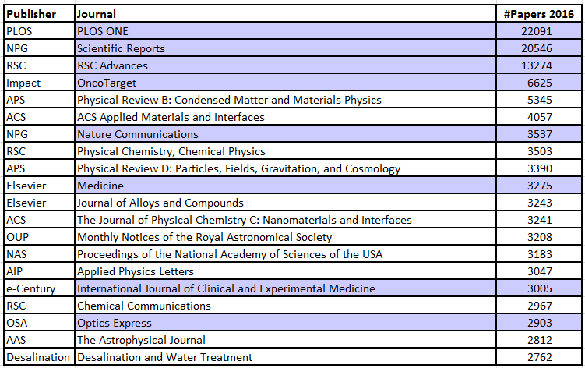
Top 20 journals worldwide: 8 gold OA
Number of papers published in 2016
Analysis based on Web of Science
OA journal
(OA as of 2017)
Open access publishing is extremely relevant.
Of the top 20 journals based on the number of articles published world-wide, 8 are gold OA journals.

Slide 4
Top 20 publishers worldwide:
Total article and OA Gold output in 2016
Number of papers published in 2016
Analysis based on Web of Science
OA dominated publisher
Rank | Publisher | Number of articles 2016 | Share of publisher 2016 | Cumulative share 2016 | Year 2016 OA Gold | Share OA Gold 2016
1 | Elsevier | 391480 | 17% | 17% | 13407 | 3,42%
2 | Springer | 185696 | 8% | 25% | 11971 | 6,45%
3 | Wiley | 142928 | 6% | 31% | 5271 | 3,69%
4 | Taylor&Francis | 83087 | 4% | 34% | 1235 | 1,49%
5 | ACS | 41929 | 2% | 36% | 102 | 0,24%
6 | RSC | 41796 | 2% | 38% | 843 | 2,02%
7 | IEEE | 38164 | 2% | 39% | 1059 | 2,77%
8 | NPG | 36615 | 2% | 41% | 25577 | 69,85%
9 | OUP | 34278 | 1% | 42% | 2914 | 8,50%
10 | LWW | 26909 | 1% | 43% | 0 | 0,00%
11 | PLOS | 25248 | 1% | 45% | 25248 | 100,00%
12 | BMC | 25098 | 1% | 46% | 24944 | 99,39%
13 | Sage | 24423 | 1% | 47% | 252 | 1,03%
14 | AIP | 20920 | 1% | 48% | 1504 | 7,19%
15 | IOP | 20834 | 1% | 48% | 1139 | 5,47%
16 | APS | 18086 | 1% | 49% | 419 | 2,32%
17 | MDPI | 15683 | 1% | 50% | 15683 | 100,00%
18 | CUP | 14467 | 1% | 50% | 157 | 1,09%
19 | Hindawi | 12350 | 1% | 51% | 11158 | 90,35%
20 | Frontiers | 11115 | 0% | 51% | 11115 | 100,00%
 | Other | 1141171 | 49% | 100% | 137710
 | Total | 2352277 |  |  | 291708
Open access publishers are among the largest in the world.
Traditional commercial publishers are increasingly open access publishers.

Slide 5
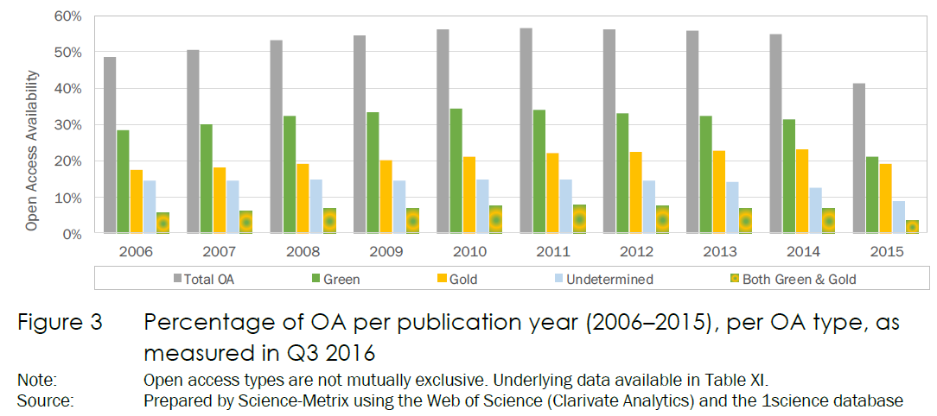


@oa2020ini
Measuring the availability of open access – example 1

Slide 6
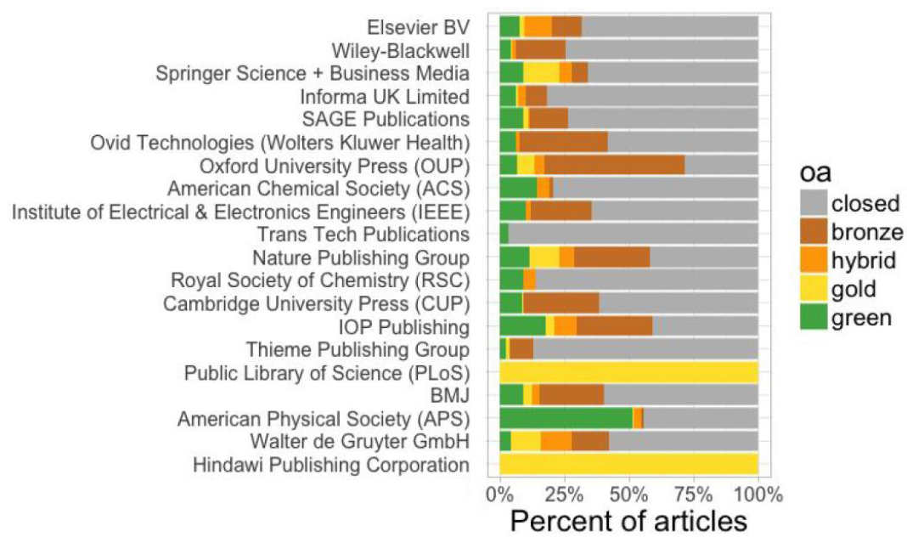
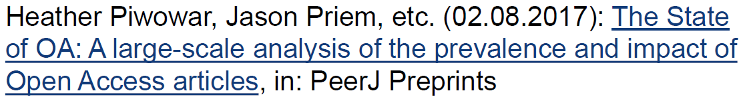
Measuring the availability of open access – example 2
Notes:
Oafinr, now called 1findr
Data sources: repositories, publisher websites, web pages of institutes/individual researchers, academic research networks
Size: 28 million articles (50% of the current scientific literature)
API: available to subscribers

Slide 7
  2. Just how open are we really?

Slide 8
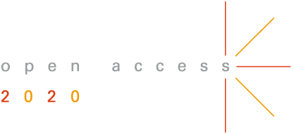
@oa2020ini
The information industry is in a whirlwind of change

Slide 9
@oa2020ini
But there is inertia in the eye of the storm

Slide 10

@oa2020ini
And what do the find in the eye of the storm?
A stagnant paywall system!

Slide 11
After 15 years of OA movement,
the paywall system remains largely unaffected
University Presses/OJS
SCOAP³
arXiv
Biomed Central
OA mandates
PLOS
Repositories
PubMed Central
Cooperative models
Community journal initiatives (e.g. LINGOA)

Slide 12
After 15 years of OA movement,
the paywall system remains largely unaffected
University Presses/OJS
SCOAP³
arXiv
Biomed Central
OA mandates
PLOS
Repositories
PubMed Central
Cooperative models
Community journal initiatives (e.g. LINGOA)

Slide 13
After 15 years of OA movement,
the paywall system remains largely unaffected

Slide 14
The paywall is a massive obstacle to progress
Only 15% of content is published immediately open access (not counting hybrid),
hindering research and the advancement of science.
A small group of large commercial publishers continue to monopolize library budgets,
limiting opportunity for other publishing entities.

Slide 15


The paywall system: antithesis of openness and opportunity
Paywall regime
Open Access
excessive costs and enormous
price increases
restrictive copyright
budgets monopolized by big deals with pricing still based on print legacy
utterly outdated system, prohibiting digital research
roadblock to innovation and new development
breeding piracy
sustainable economic models, transparency and competition
free usage rights
money free to float where needed, costs based on service levels
open system, responding to the need of the 21st century
fundamental principle to enable the richness of Open Science
enabling legitimate social academic networks
The paywall is the primary roadblock to openness, innovation and sustainability.

Slide 16





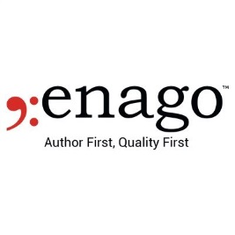
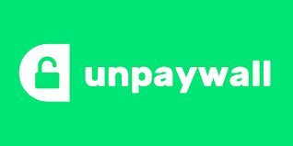


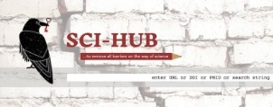


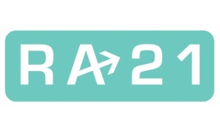
Characteristics of the paywall system
Pre-publishing
Publishing
Post-publishing
Publication continuum
Submission layer &
Publication support services
closed system
hindering use,
reuse and
interoperability
$10bn
cash flow
15

Slide 17
Relieving symptoms, but not curing the cause
Just two examples of creative solutions:
Innovators are limited to creating work-arounds to the current access and copyright restrictions
Expend enormous effort on “patches” that grow in complexity
Can relieve the symptoms somewhat; but they cannot provide a cure for the disease
Real innovation will come when energies can be focused on
forward-looking solutions in an open environment.

Slide 18
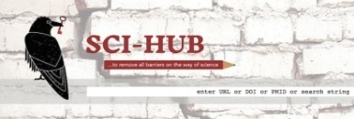
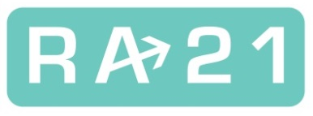
The evil twins: SciHub and RA21
Expression of end-user frustration
Essentially tied to the paywall system
Symptomatic of a dysfunctional and decaying system
A mirror of negative elements; not the carrier of a positive open access vision
Another example of working around the real solution
Resource Access 21 was already defined in the Declarations of Budapest (2002) and Berlin (2003):
it is designated Open Access
OA is the only legitimate resource access in the 21st century and the best possible single sign-on system
SciHub and RA21 seem to be diametrically opposed, but they are twins and together the epitome of what is wrong with the current system.

Slide 19




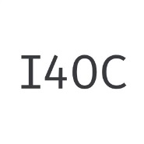
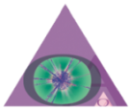


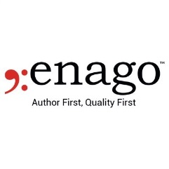
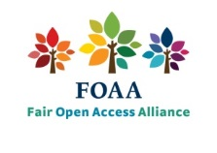





Characteristics of an open system
Pre-publishing
Publishing
Post-publishing
Publication continuum
Submission layer &
Publication support services
Open system,
allowing
maximum (re-)use
and interoperability

Slide 20
The opportunities of an open system
Pre-publishing
Publishing
Post-publishing
Publication continuum
Submission layer &
Publication support services
Open system,
allowing
maximum (re-)use
and interoperability
Emerging service arena:
New market entries, systems & services
Healthy competition:
Publishers provide core services based on a transparent cost structure
Exponential growth:
New collaborative tools and services, social academic networks; text and data mining promise finally fulfilled
In order to drive innovation and exploit the technological opportunities,
the principle of openness must be adopted as the default in the scholarly communications.
For that, the paywall must come down!

Slide 21




The paywall system is the ‘elephant’ in the room
$10bn
cash flow

Slide 22
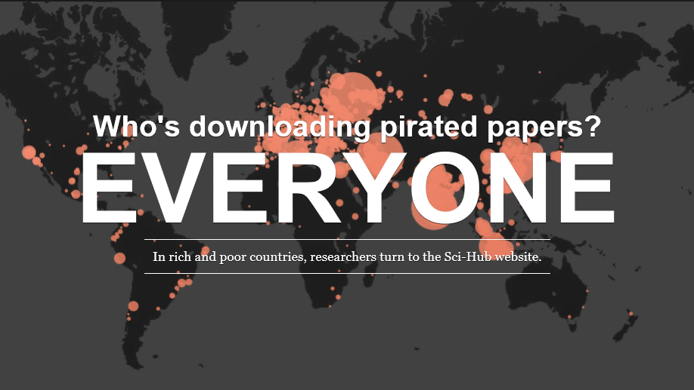
One of the many lessons of SciHub…
John Bohannon: Who’s downloading pirated papers? Everyone, in: Science Mag, Apr. 28, 2016.
http://www.sciencemag.org/news/2016/04/whos-downloading-pirated-papers-everyone

Slide 23
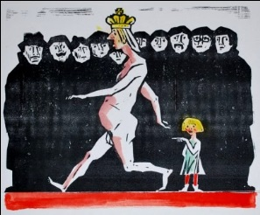
…is to expose the vulnerability of the current system.
The Emperor's New Clothes, a fairy tale by Hans Christian Andersen, Denmark (1837)
https://41.media.tumblr.com/0e1dbf83f053703568913d04a526fcb1/tumblr_inline_o3m3oc2kCO1sxr3js_540.jpg

Slide 24
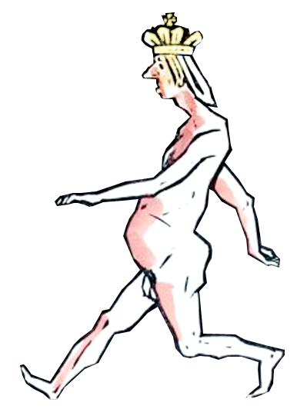

Do we really think we can continue to do business as usual?

Slide 25
The way forward is crystal clear
The subscription based paywall system must be overcome as radically and quickly as possible.
Open Access on a large scale can only be accomplished if and as soon as we change the underlying business model of today’s scholarly journals and leave the subscription system behind.

Slide 26



The consequential shift yet to happen
Paywall regime
Open Access
$10bn
cash flow
The revenue stream must be shifted,
and journals change to a truly open publishing model.

Slide 27
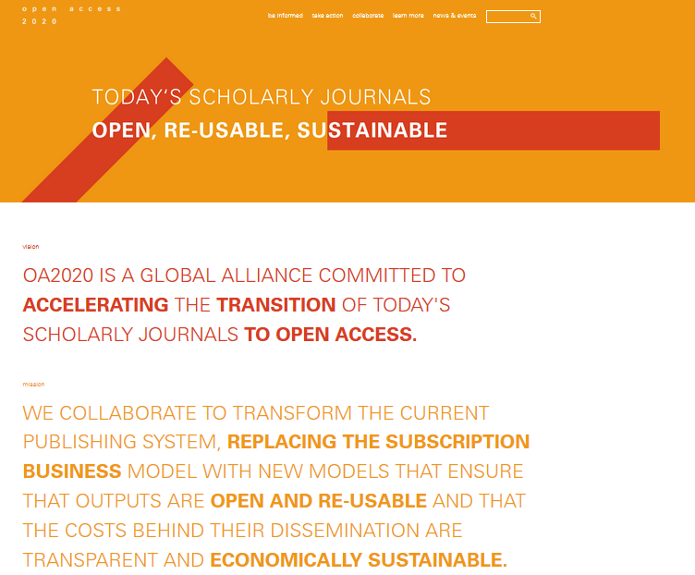
Open Access 2020 Initiative
https://oa2020.org

Slide 28
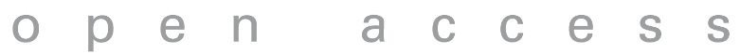
Time to unplug the paywall system
In order to foster the development of innovative services that are wanted and needed in the 21st century, we must abandon the subscription system.

Slide 29
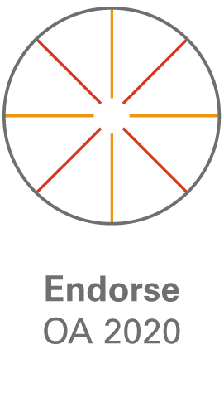
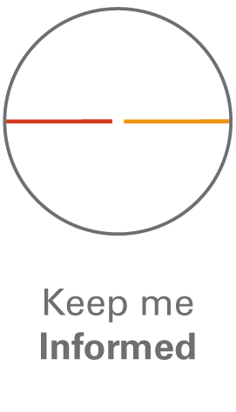
Thank you!
Colleen Campbell
Open Access 2020 Initiative, Max Planck Digital Library
campbell@mpdl.mpg.de
https://oa2020.org
@oa2020ini

