Slide 1
Promoting Integrity in Research and Its Publication: How COPE Supports Editors and Publishers
The 7th International Scientific and Practical Conference “World-class scientific publication”
26 April 2018, Moscow, Russia
Behrooz Astaneh M.D
COPE Council Member
Head, Medical Journalism Department, Shiraz University of Medical Sciences
Editor-in-Chief, Iranian Journal of Medical Sciences
Vice President, EMAME
Vice President, Iranian Society of Medical Editors

Slide 2
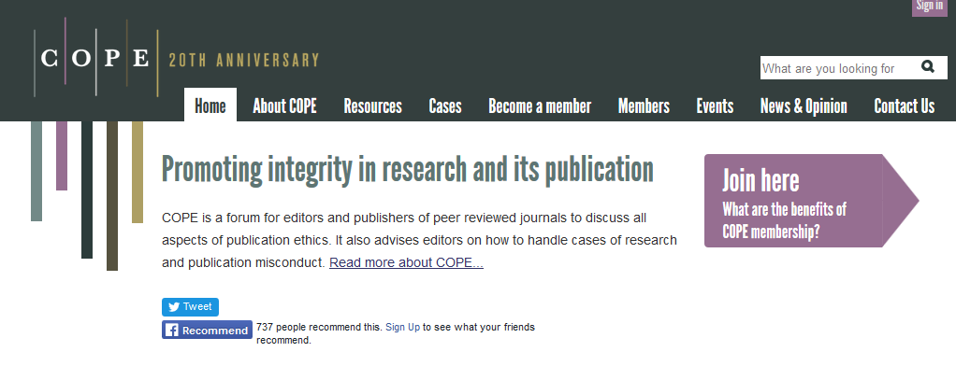
What is COPE?
Notes:
Membership organisation – promote integrity….. Highlight key points.
From http://publicationethics.org/files/u7140/StrategicPlan2016_2018.pdf

Slide 3
What are we and who are we?
As an organization, COPE’s role is to assist editors of scholarly journals and publisher/owners in their endeavour to preserve and promote the integrity of the scholarly record through policies and practices that reflect the current best principles of transparency as well as integrity.
COPE is a membership organization. Our members are primarily editors of journals and publishers although we are currently exploring expanding our membership. Part of this potential expansion is being explored with a pilot project with five universities around the world.
COPE operates, manages and governs the organization with a small group of paid employees and a large group of very active volunteers who serve on the trustee board and council.

Slide 4
10+ Trustees
Members of Council with
legal responsibilities for COPE
30+ Council members
Lead all the work of COPE,
Subcommittees, Working groups
12,000+ members

Slide 5
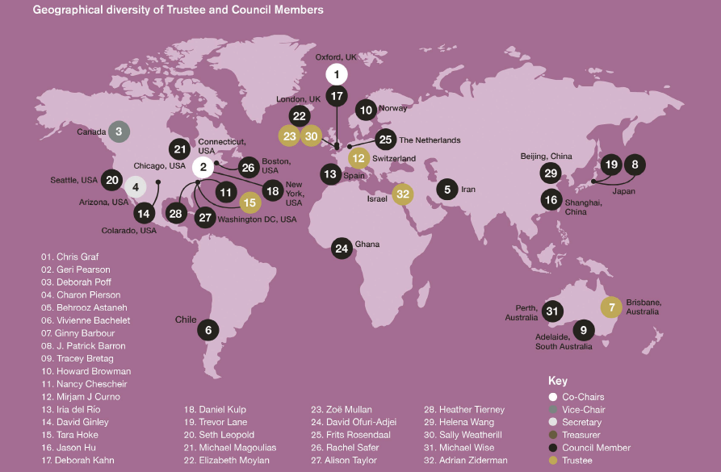

Slide 6
What are the big issues?

Slide 7
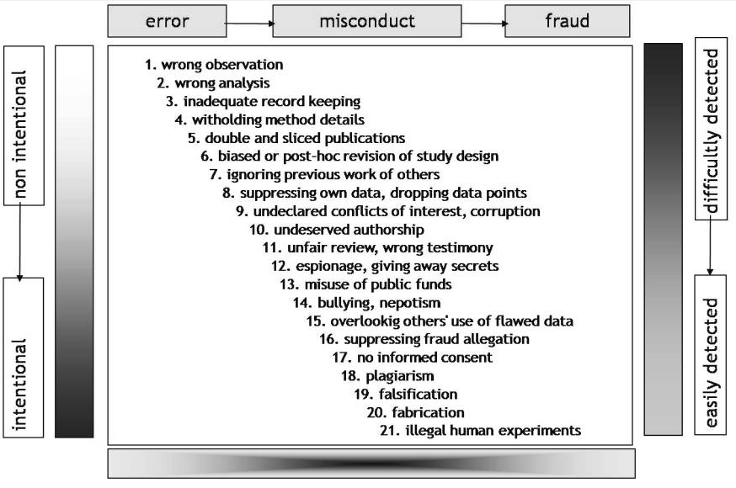
Marcovitch et al. Croat Med J. 2010 doi: 10.3325/cmj.2010.51.7
Notes:
By editor
By software
By reviewers
By authors
During peer review
And post-publication (readers)

Slide 8
What help can you get?

Slide 9
COPE resources and services
A neutral place (forum) to discuss issues
Searchable database of ‘cases’
A website of freely available resources
Flowcharts
Core Practices
Discussion documents
Seminars/workshops
elearning modules
Guidelines

Slide 10
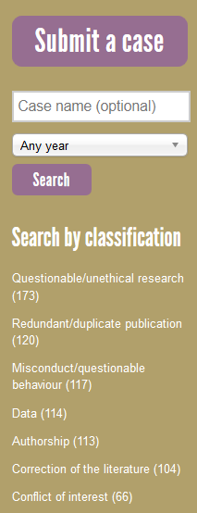
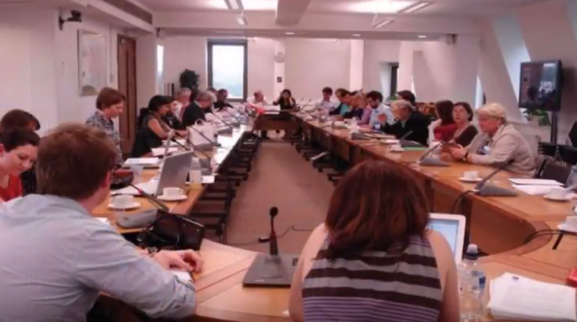
COPE forum
Anonymous description of real issues (cases)
Discussion
Advice, follow up, resolution
Searchable resource

Slide 11
Cases
Withdrawing from authorship (17-10). An already published paper is under investigation by the host institution for misconduct. After investigations started, an author asked to be removed from authorship. What should the journal do?
https://publicationethics.org/case/withdrawing-authorship

Slide 12
Cases
ADVICE: Postpone any decision until after the investigation. Consider publishing an expression of concern. Await the outcome of the investigation before making any changes to the paper. This could be thought of as an authorship dispute. Are all the authors from the same institution? The author may have a legitimate reason for wanting to be removed if he is from a different institution. A suggestion for the editor was to ask the author why he wishes to be removed from the article. Most of the Forum agreed with a robust “no” to the request, and with contacting the institution.
https://publicationethics.org/case/withdrawing-authorship

Slide 13
Cases
Duplicate submission (09-15). We received a manuscript for consideration. The editor-in-chief received an invitation from another journal to review the same paper. We emailed the authors of the paper asking for an explanation. The authors withdrew their paper from the second journal. The corresponding author hoped that we would still consider his submission. We are unsure as to how to proceed.
https://publicationethics.org/case/duplicate-submission-2

Slide 14
Cases
ADVICE: There was conflicting advice. Some suggested rejecting the paper, while others thought it was more appropriate to write a firm letter to the authors explaining that their behaviour was unacceptable. It was also suggested copying the letter to the dean of the author’s institution so that the institution could put in place guidelines on submission of papers so that this does not occur again.
https://publicationethics.org/case/duplicate-submission-2

Slide 15
Advice
Signs that might indicate authorship problems
Corresponding author is unable to respond to reviewers’ comments.
Changes are made by somebody not on the author list (check Word document properties but there may be an innocent explanation)
Document properties show the manuscript was drafted by someone not on the author list or properly acknowledged (but see above)
Impossibly prolific author e.g. of review articles/opinion pieces (detected by a Medline or Google search using the author’s name)
Several similar review articles/editorials/opinion pieces published under different author names (detected by a Medline or Google search)
Role missing from list of contributors (e.g. it appears that none of the authors were responsible for analysing the data or drafting the paper)
Unfeasibly long or short author list (e.g. a simple case report with a dozen authors or a randomised trial with a single author
https://publicationethics.org/files/u7140/Authorship%20problems.pdf

Slide 16
Advice
How to recognise potential manipulation of the peer review process
The features or patterns of activity shown are suggested to help recognise potential signs of peer review manipulation.
Often it is the occurrence of these features in combination that may indicate a potential issue.
https://publicationethics.org/files/COPE%20PR_Manipulation_Process.pdf

Slide 17
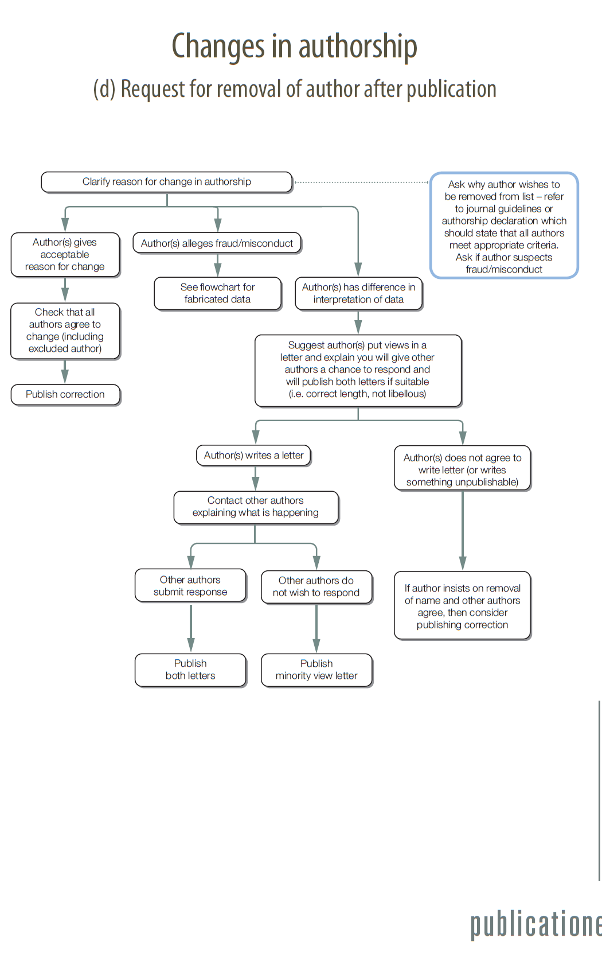
https://publicationethics.org/resources/flowcharts
Flowcharts

Slide 19
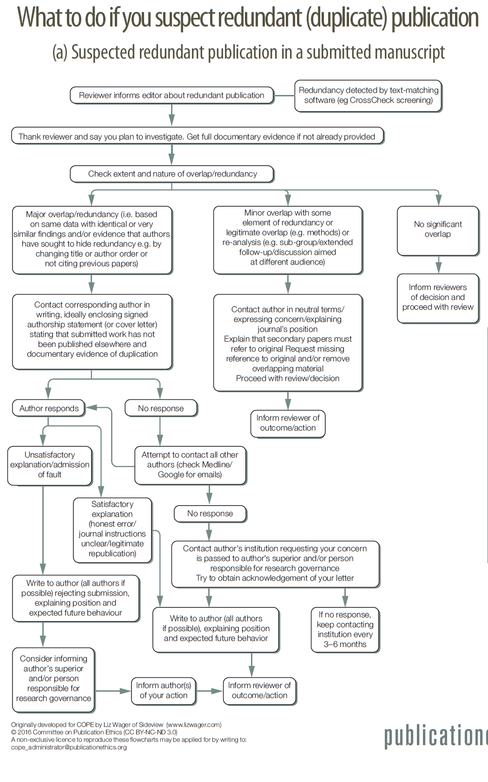
Flowcharts
Notes:
Persian, French, Chinese, ….

Slide 22
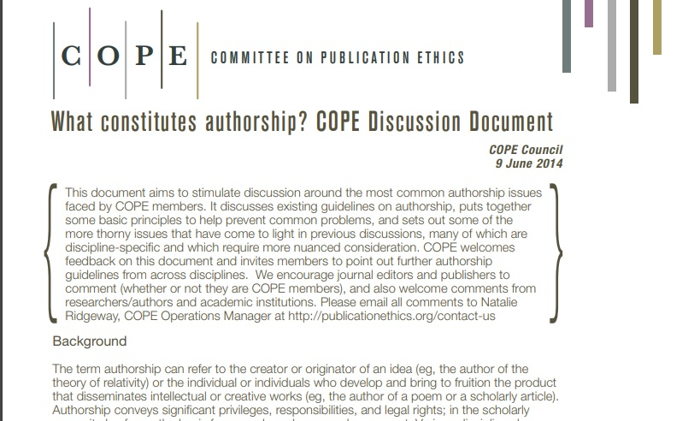
‘‘
Discussion documents
What constitutes authorship? This document aims to stimulate discussion around the most common authorship issues faced by COPE members. It discusses existing guidelines on authorship, puts together some basic principles to help prevent common problems, and sets out some of the more thorny issues that have come to light in previous discussions, many of which are discipline-specific and which require more nuanced consideration.
https://publicationethics.org/files/u7141/What%20constitutes%20authorship%20Chinese.pdf

Slide 23
Guidelines

Slide 26
Guidelines

Slide 27
Guidelines

Slide 28
Guidelines

Slide 29
Guidelines: Retractions
This is an extract. Please, read the whole guideline. Editors should consider retracting a publication if:
They have evidence that the findings are unreliable, either as a result of misconduct (e.g. data fabrication) or honest error (e.g. miscalculation)
The findings have been published elsewhere without cross-referencing, permission or justification (i.e. redundant publication)
It constitutes plagiarism or reports unethical research
Retraction is a mechanism for correcting the literature and alerting readers to publications that contain such seriously flawed or erroneous data that their findings and conclusions cannot be relied upon. Unreliable data may result from honest error or from research misconduct.
The main purpose of retractions is to correct the literature and ensure its integrity rather than to punish authors who misbehave.
https://publicationethics.org/files/retraction%20guidelines.pdf

Slide 30
Thank you! — publicationethics.org —

